Slide 1
Version Control: Not Just for Software
Lab Meeting – 2024.1.19

Slide 2
What is Version Control?
“Version control systems are software tools that help software teams manage changes to source code over time.”
“VC software keeps track of every modification to the code in a special kind of database.”
Integral for collaboration – how to handle multiple people editing the same file, potentially changing the same things!
Works the best for text-based documents (.txt, .csv, code, etc.), but can also work with binary files (.xlsx, .pptx, .docx)
Quotes from Atlassian git tutorial, emphasis mine

Slide 3
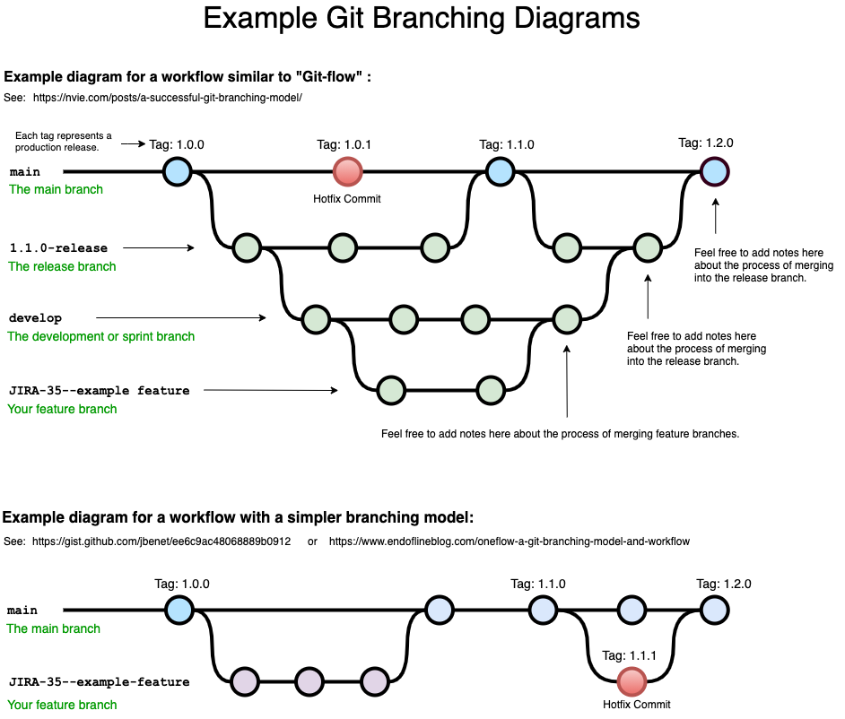
Benefits
Complete change history
control over change logs
Can rollback to earlier versions at any time
Branches, and their associated merging
This is how parallel editing is managed
will get into later
Cloud storage
Create Figure 1
Adjustment to figure 1
Image from Bryan Braun

Slide 4



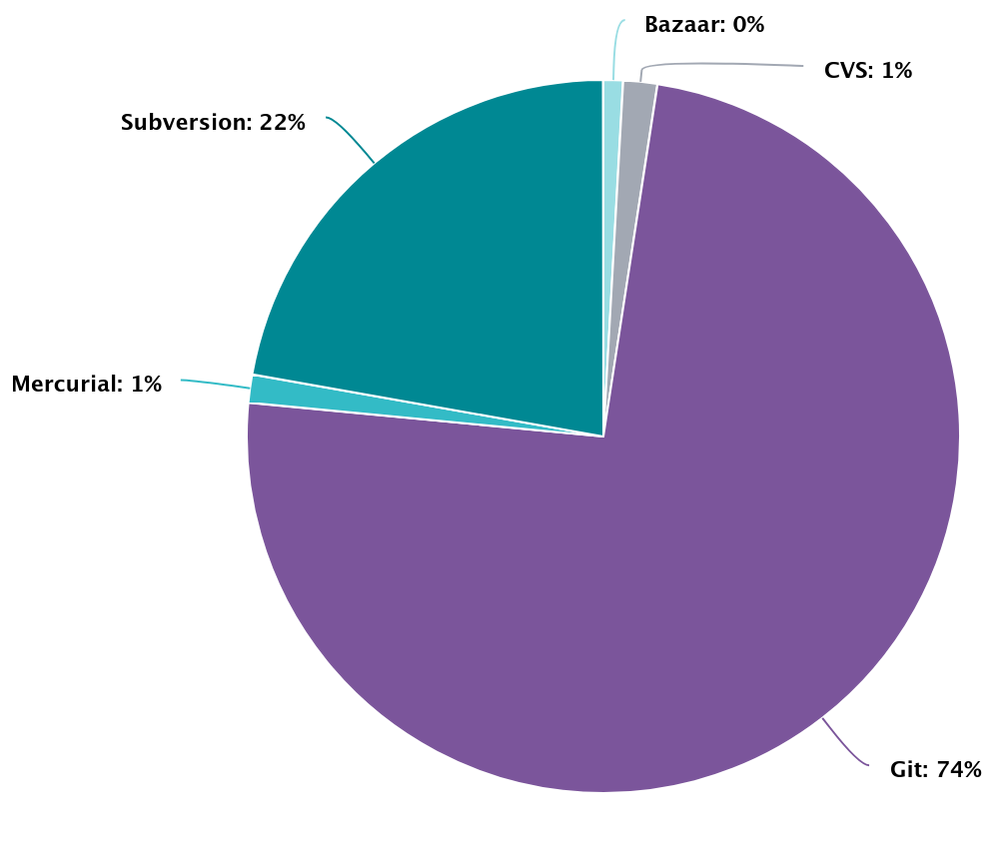




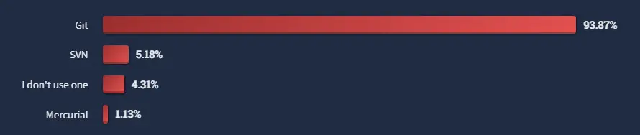
+
Most popular and widely-used version control software
Developed in ~10 days by Linus Torvalds (inventor of Linux)
Is a “distributed” version control system
Everyone has a remote copy
Solves the political issue of “who can make changes”
Awesome GUI and associated website (github.com) makes it easy to collaborate and share repositories.
Openhub.net
Stackoverflow user interview January 2023
Notes:
Openhub is platform aimed at indexing the open-source software development community.

Slide 5
Definitions/Commands
Repo(sitory) – a specific, version-controlled project
Local copies on your individual computer
“remote” copies on github.com
Branch – a specific version of a repository
Command line – a mouse-less interface
Move, copy, open files (just like in Finder)
Run commands (similar to clicking an icon to open it)
Graphical User Interface – mouse interface
Word, Rstudio, web browser, etc.
Github Desktop
pull – grab changes from remote
fetch – just view changes from remote
add – notify git of changes
commit – log changes
branch – create a new branch
checkout – navigate branches
push – send local changes to remote
merge – combine two branches

Slide 6
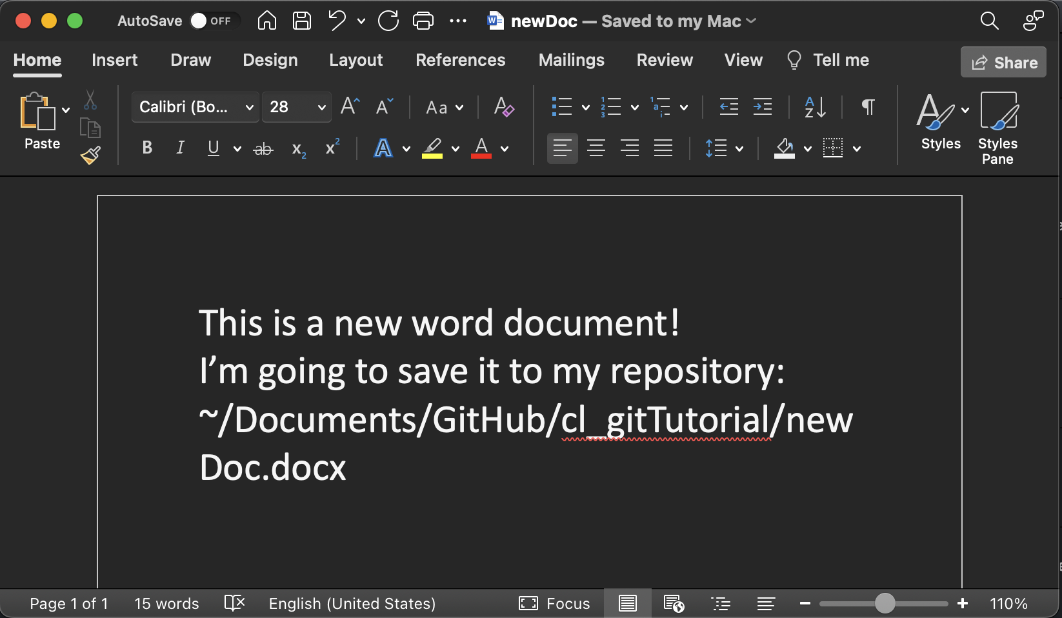
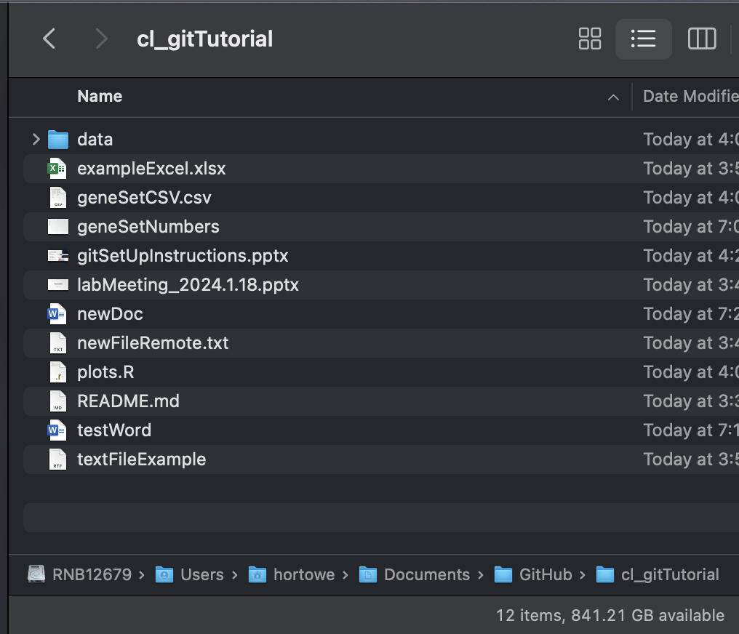
Standard Workflow - Individual
Make a new file or change an existing file
Notify git that you changed something
Create a log of your change
Push those changes

Slide 7
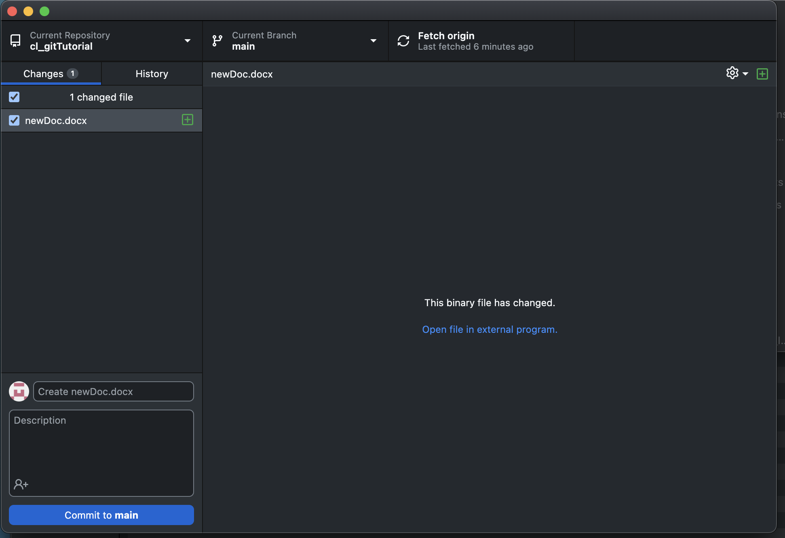
Standard Workflow - Individual
Make a new file or change an existing file
Notify git that you changed something
Create a log of your change
Push those changes
The desktop app automatically detects changes

Slide 8
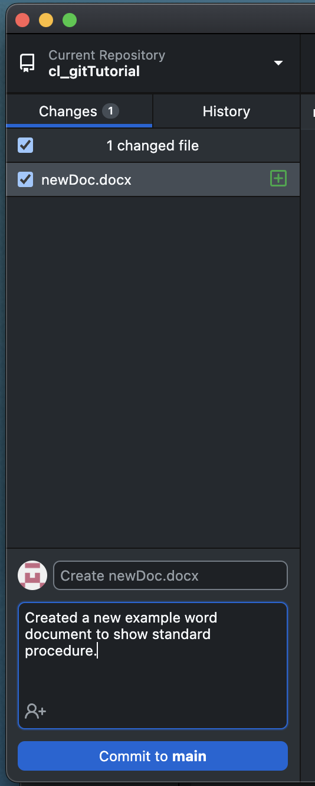
Standard Workflow - Individual
Make a new file or change an existing file
Notify git that you changed something
Create a log of your change
Push those changes

Slide 9
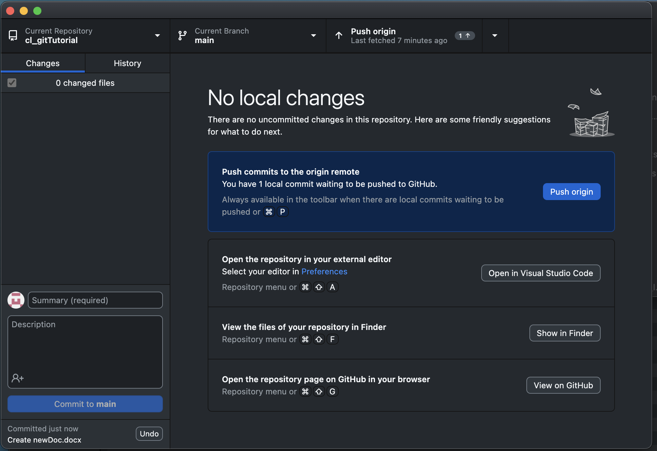
Standard Workflow - Individual
Make a new file or change an existing file
Notify git that you changed something
Create a log of your change
Push those changes (optional)

Slide 10
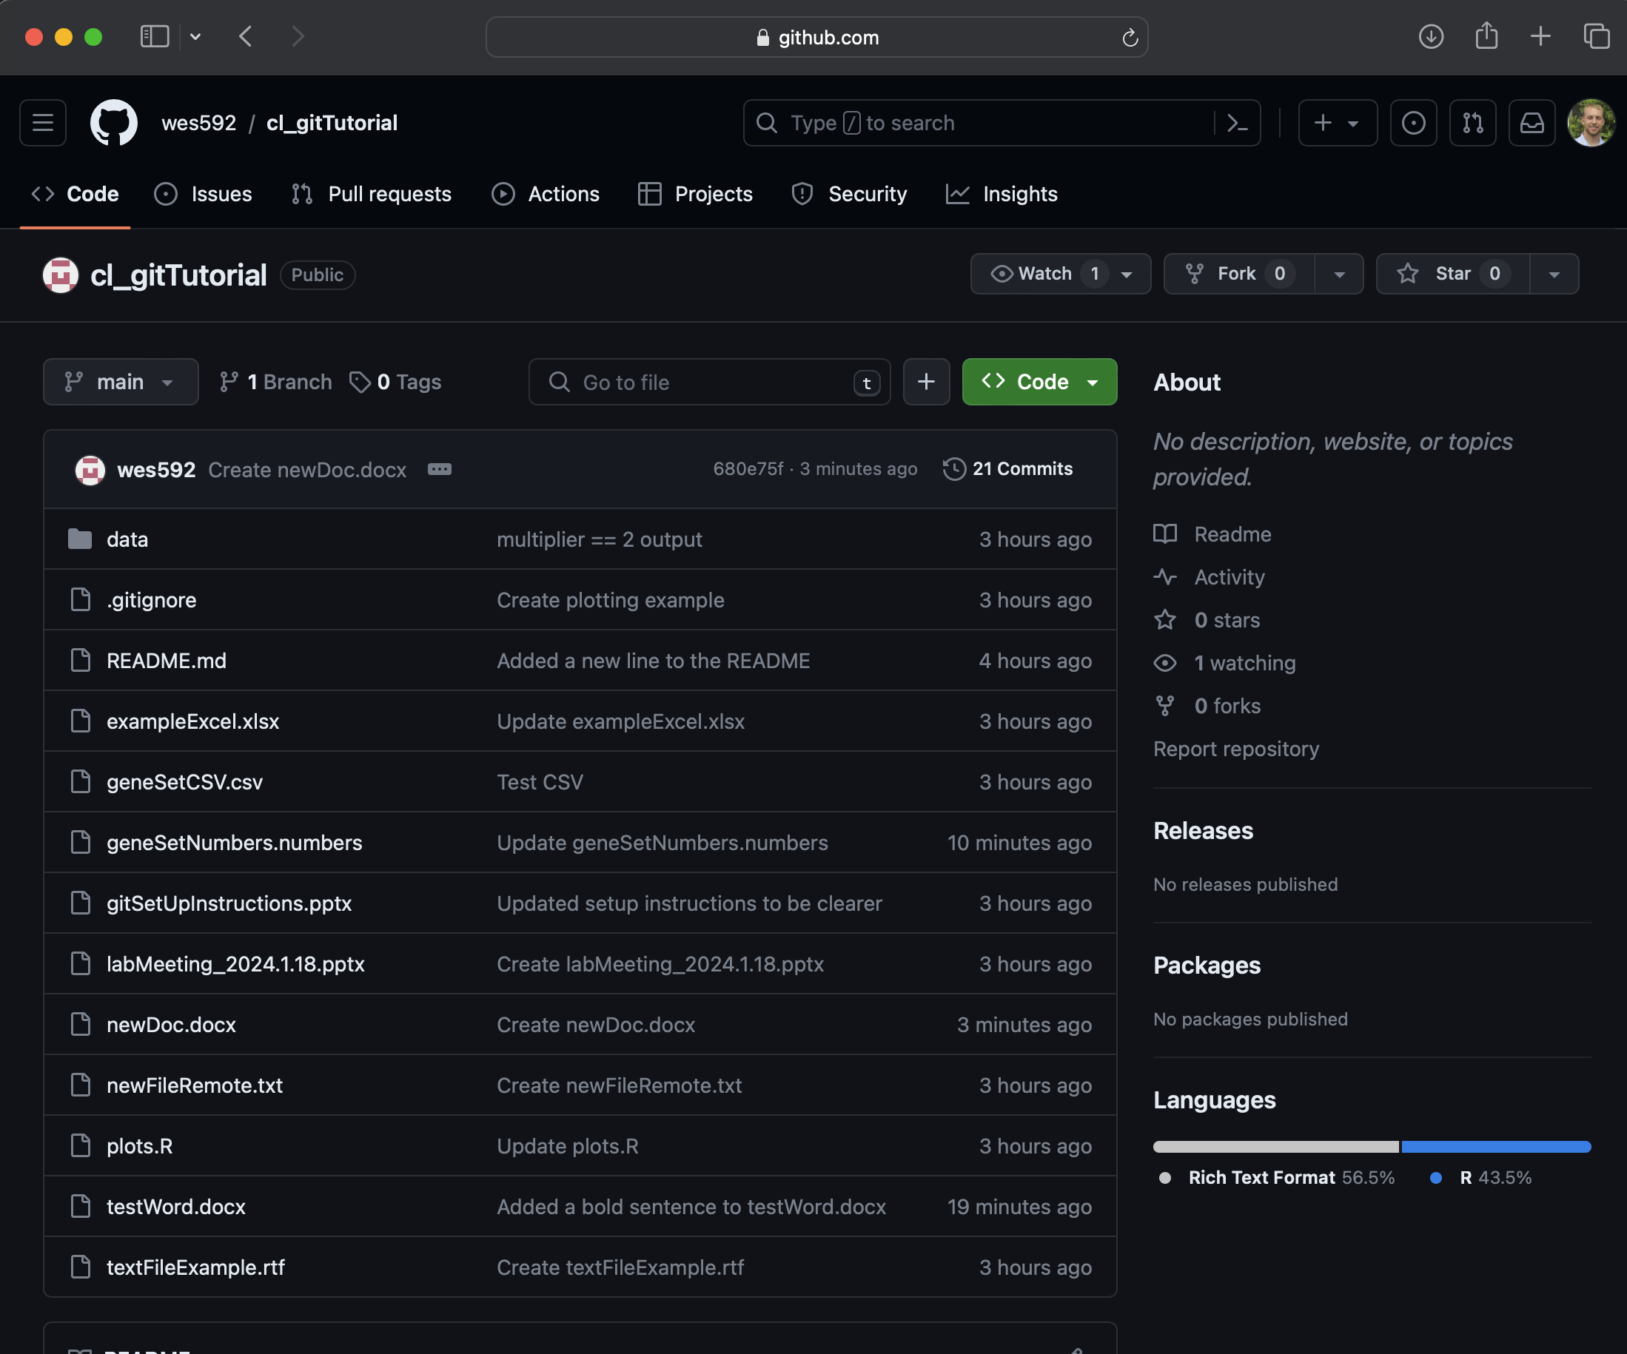
Standard Workflow - Individual
Make a new file or change an existing file
Notify git that you changed something
Create a log of your change
Push those changes (optional)

Slide 11
How I use git
R package development
Tracking code used for specific projects/data
Sharing code
Easily switching between working on my local computer, the galaxy supercomputer, and exacloud

Slide 12
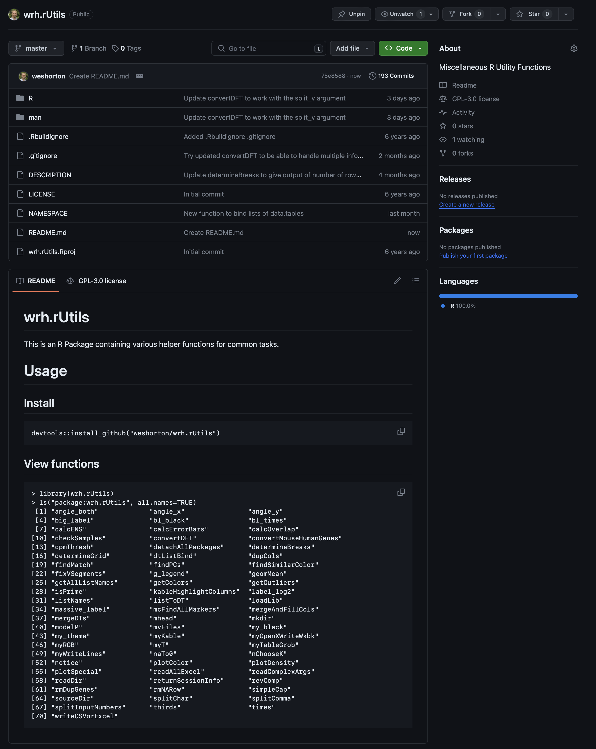
R Package Development
Hosted online so I can collaborate with anyone
Can quickly see the latest change in each file
Look at my entire commit history
Tracking, sharing, and switching computers are all also used for this!

Slide 13
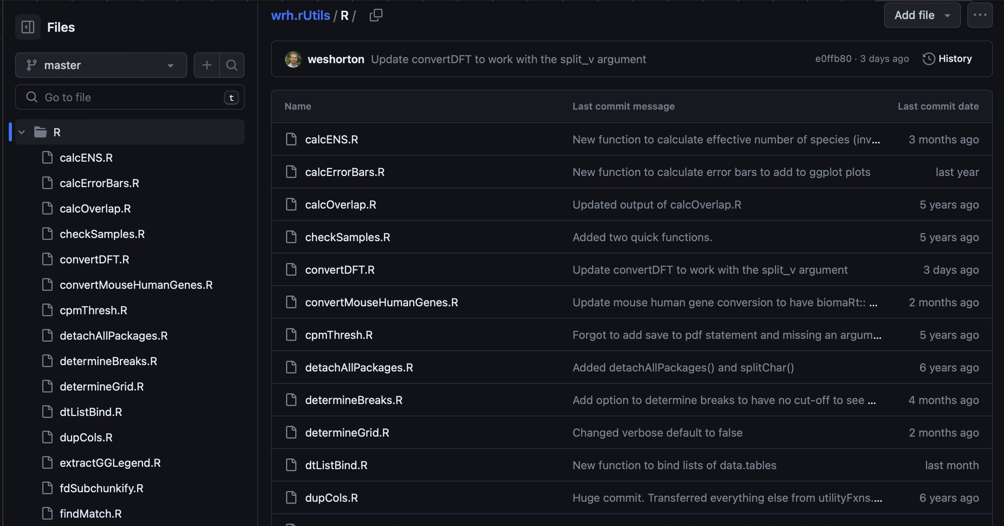
R Package Development
Hosted online so I can collaborate with anyone
Can quickly see the latest change in each file
Look at my entire commit history

Slide 14
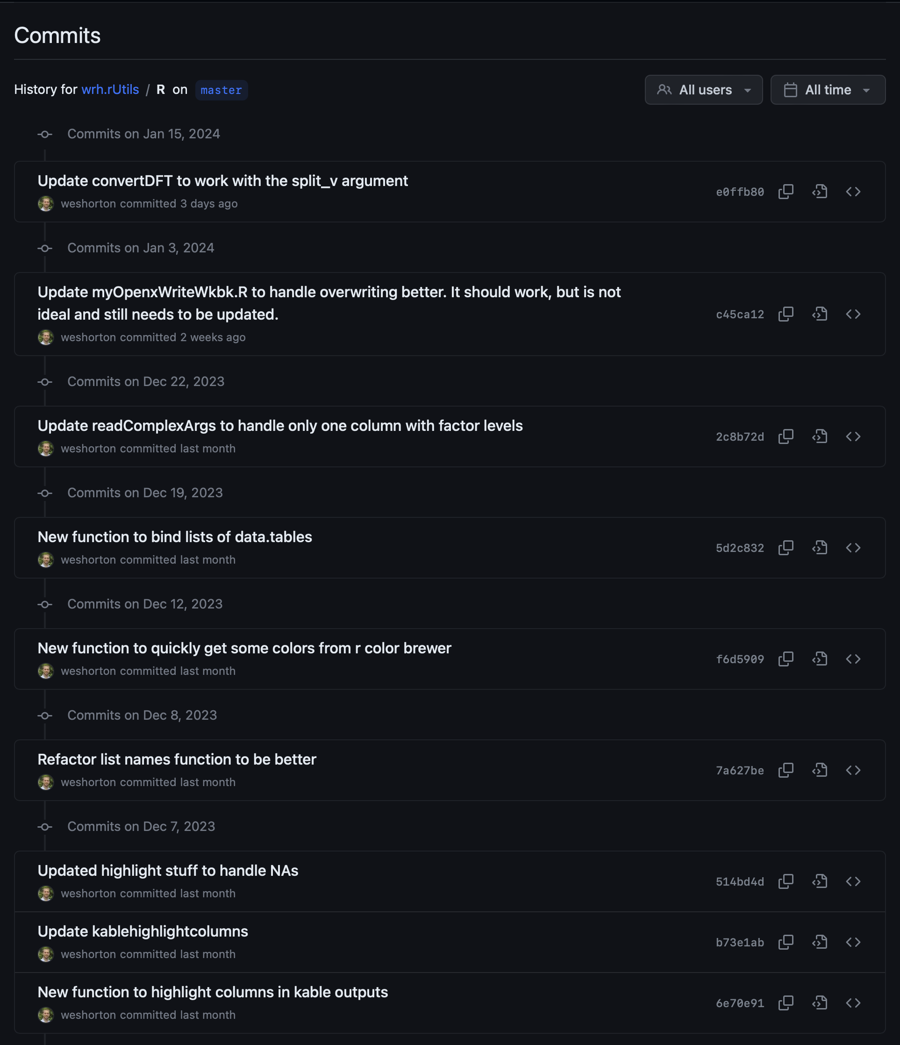
R Package Development
Hosted online so I can collaborate with anyone
Can quickly see the latest change in each file
Look at my entire commit history

Slide 15
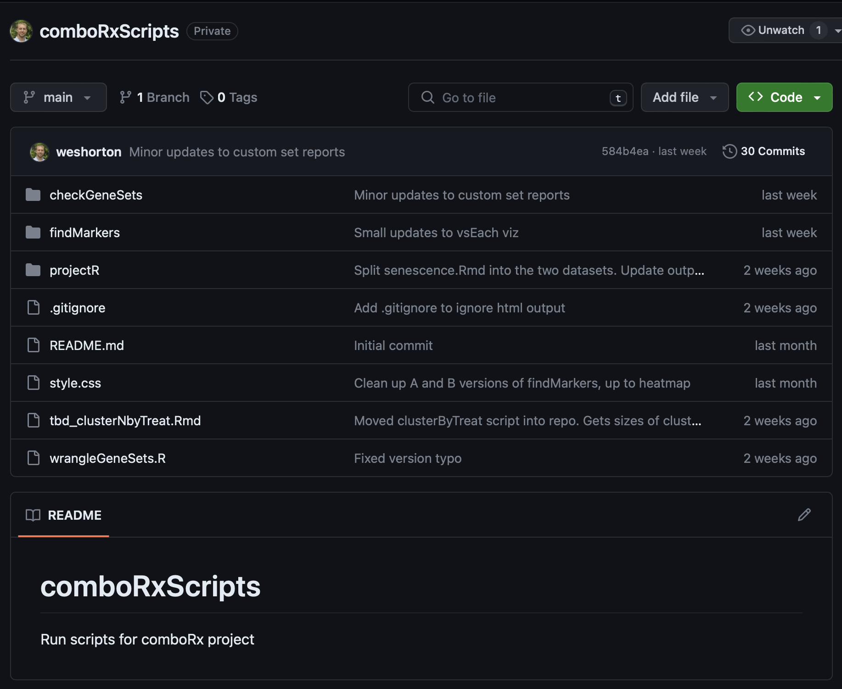
Tracking Code
Track updates as I work on the combo project
See when we started using a newer version of the custom gene sets
See when new mIHC projects were added and run

Slide 16
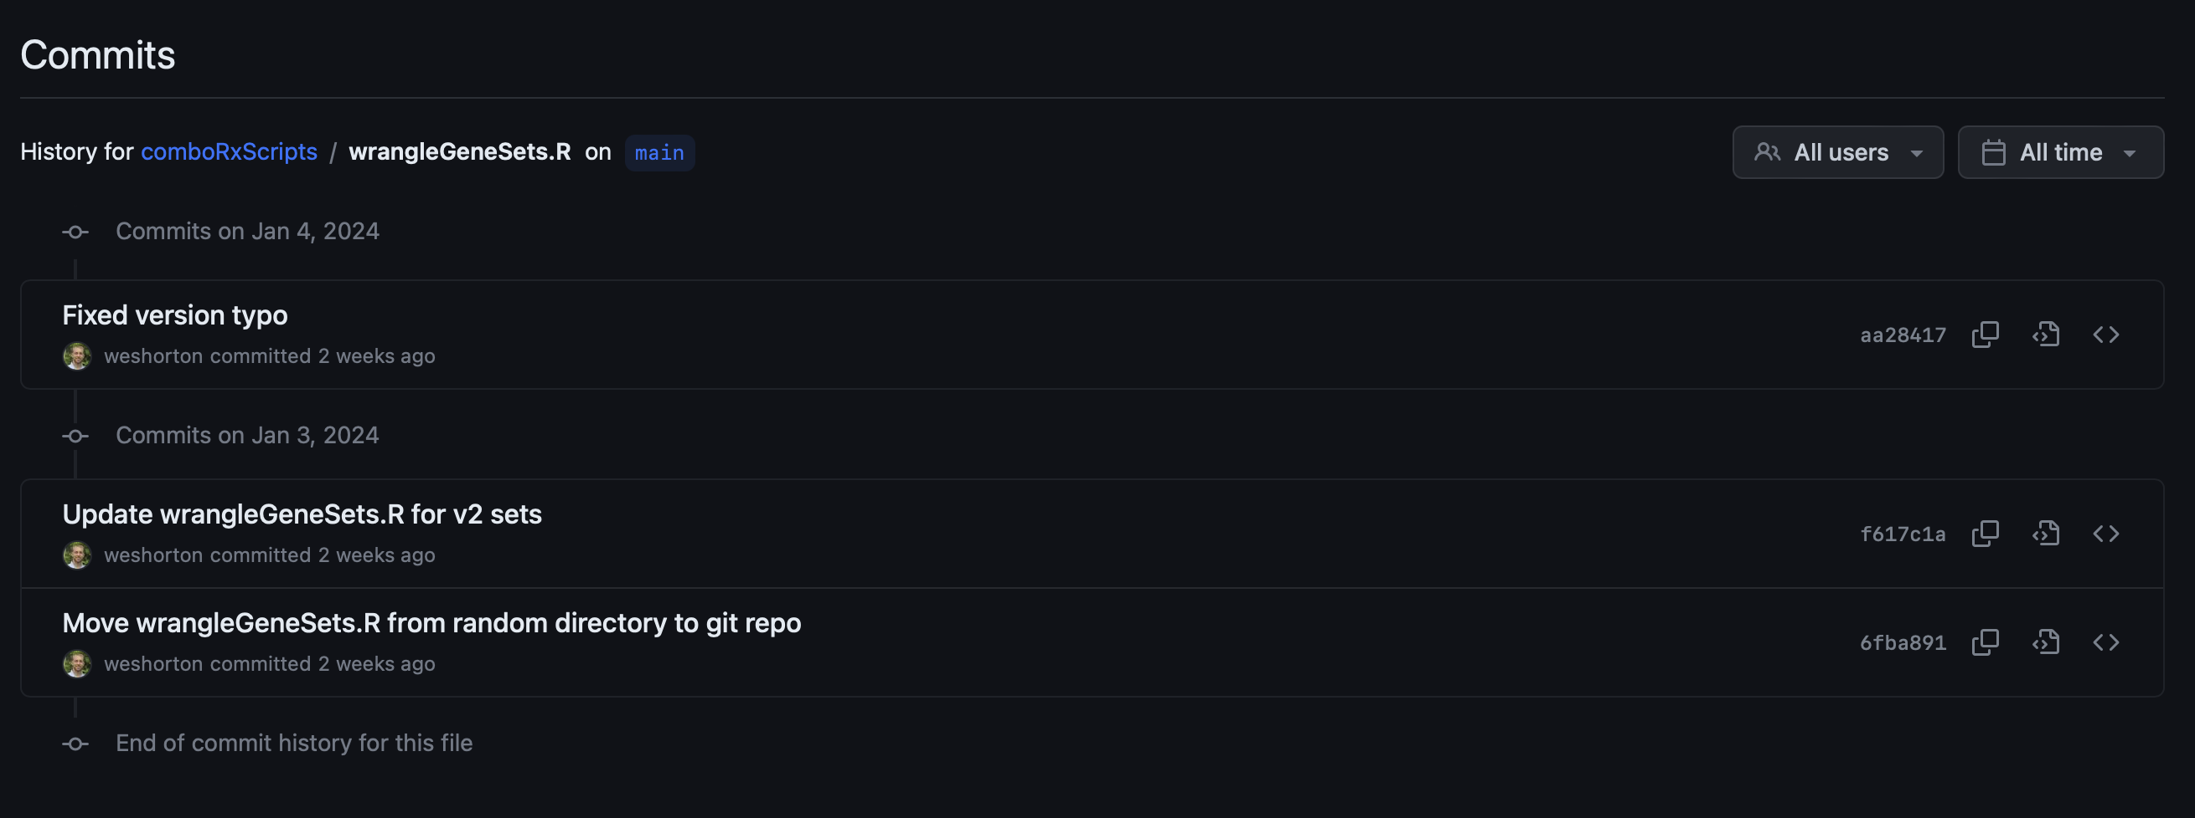
Tracking Code
Track updates as I work on the combo project
See when we started using a newer version of the custom gene sets
See when new mIHC projects were added and run

Slide 17
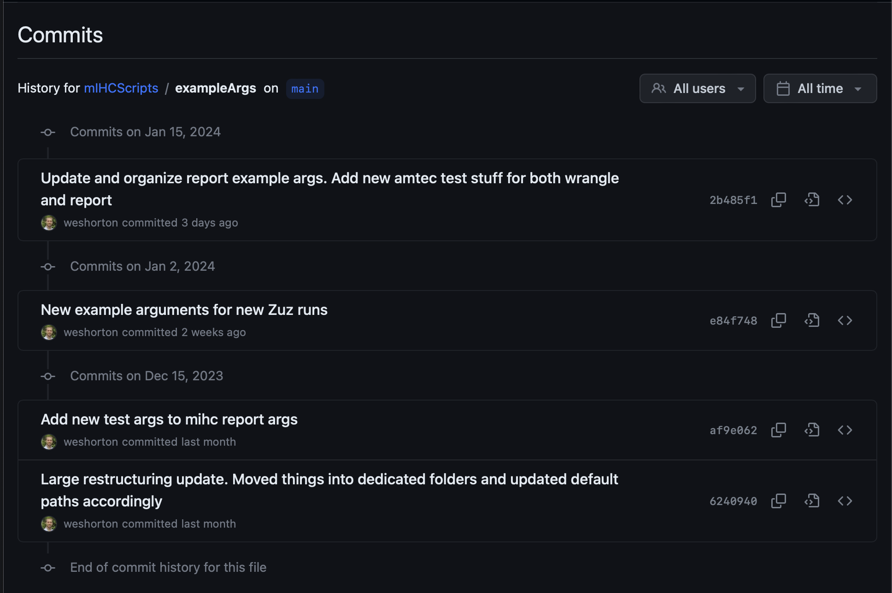
Tracking Code
Track updates as I work on the combo project
See when we started using a newer version of the custom gene sets
See when new mIHC projects were added and run

Slide 18
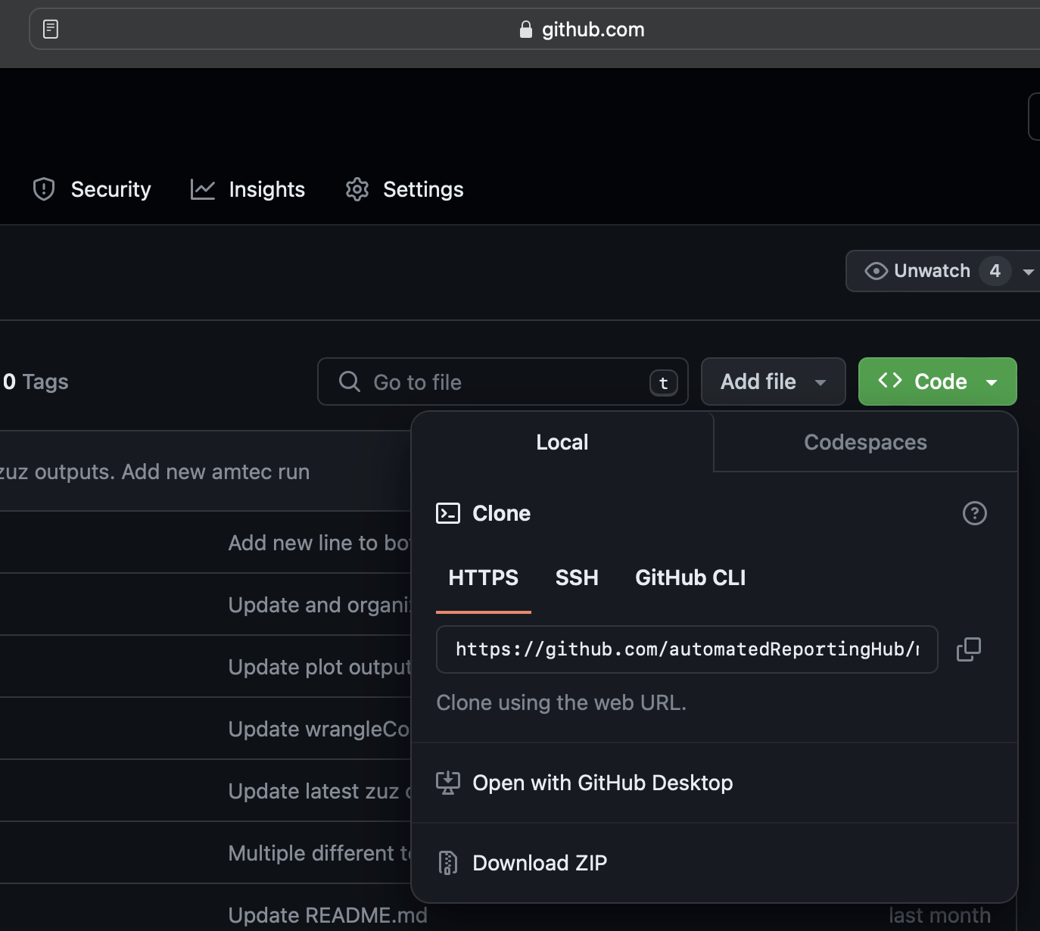
Sharing Code/Switching Locations
Anyone with a link and permission can access your repository
Share instructions, descriptions of the data, etc.
Have the exact same versions in multiple locations

Slide 19
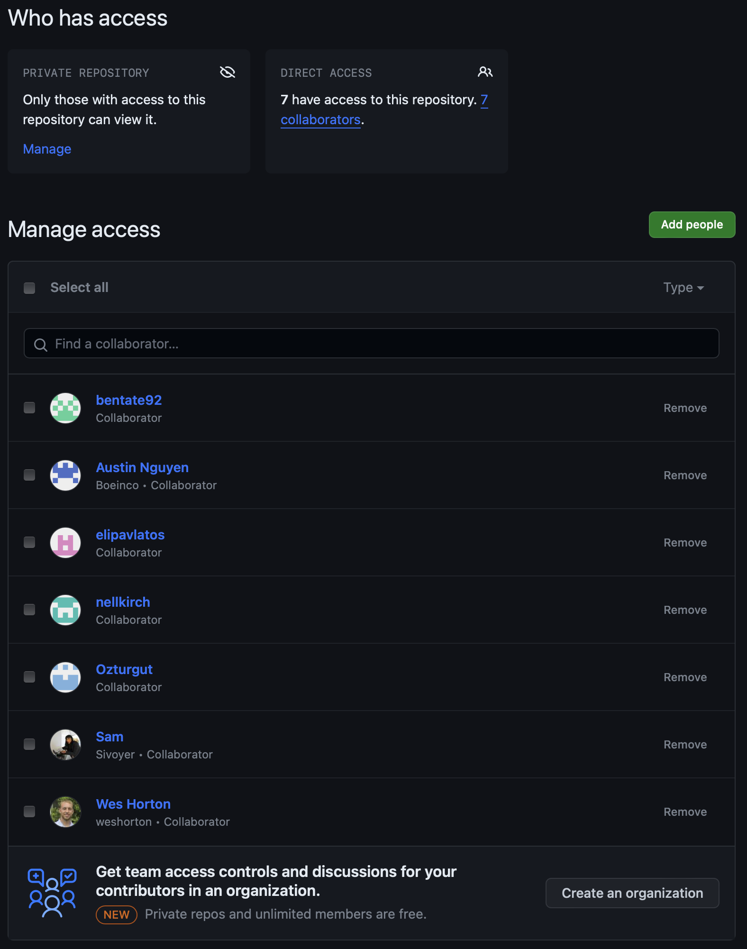
Sharing Code/Switching Locations
Anyone with a link and permission can access your repository
Share instructions, descriptions of the data, etc.
Have the exact same versions in multiple locations

Slide 20
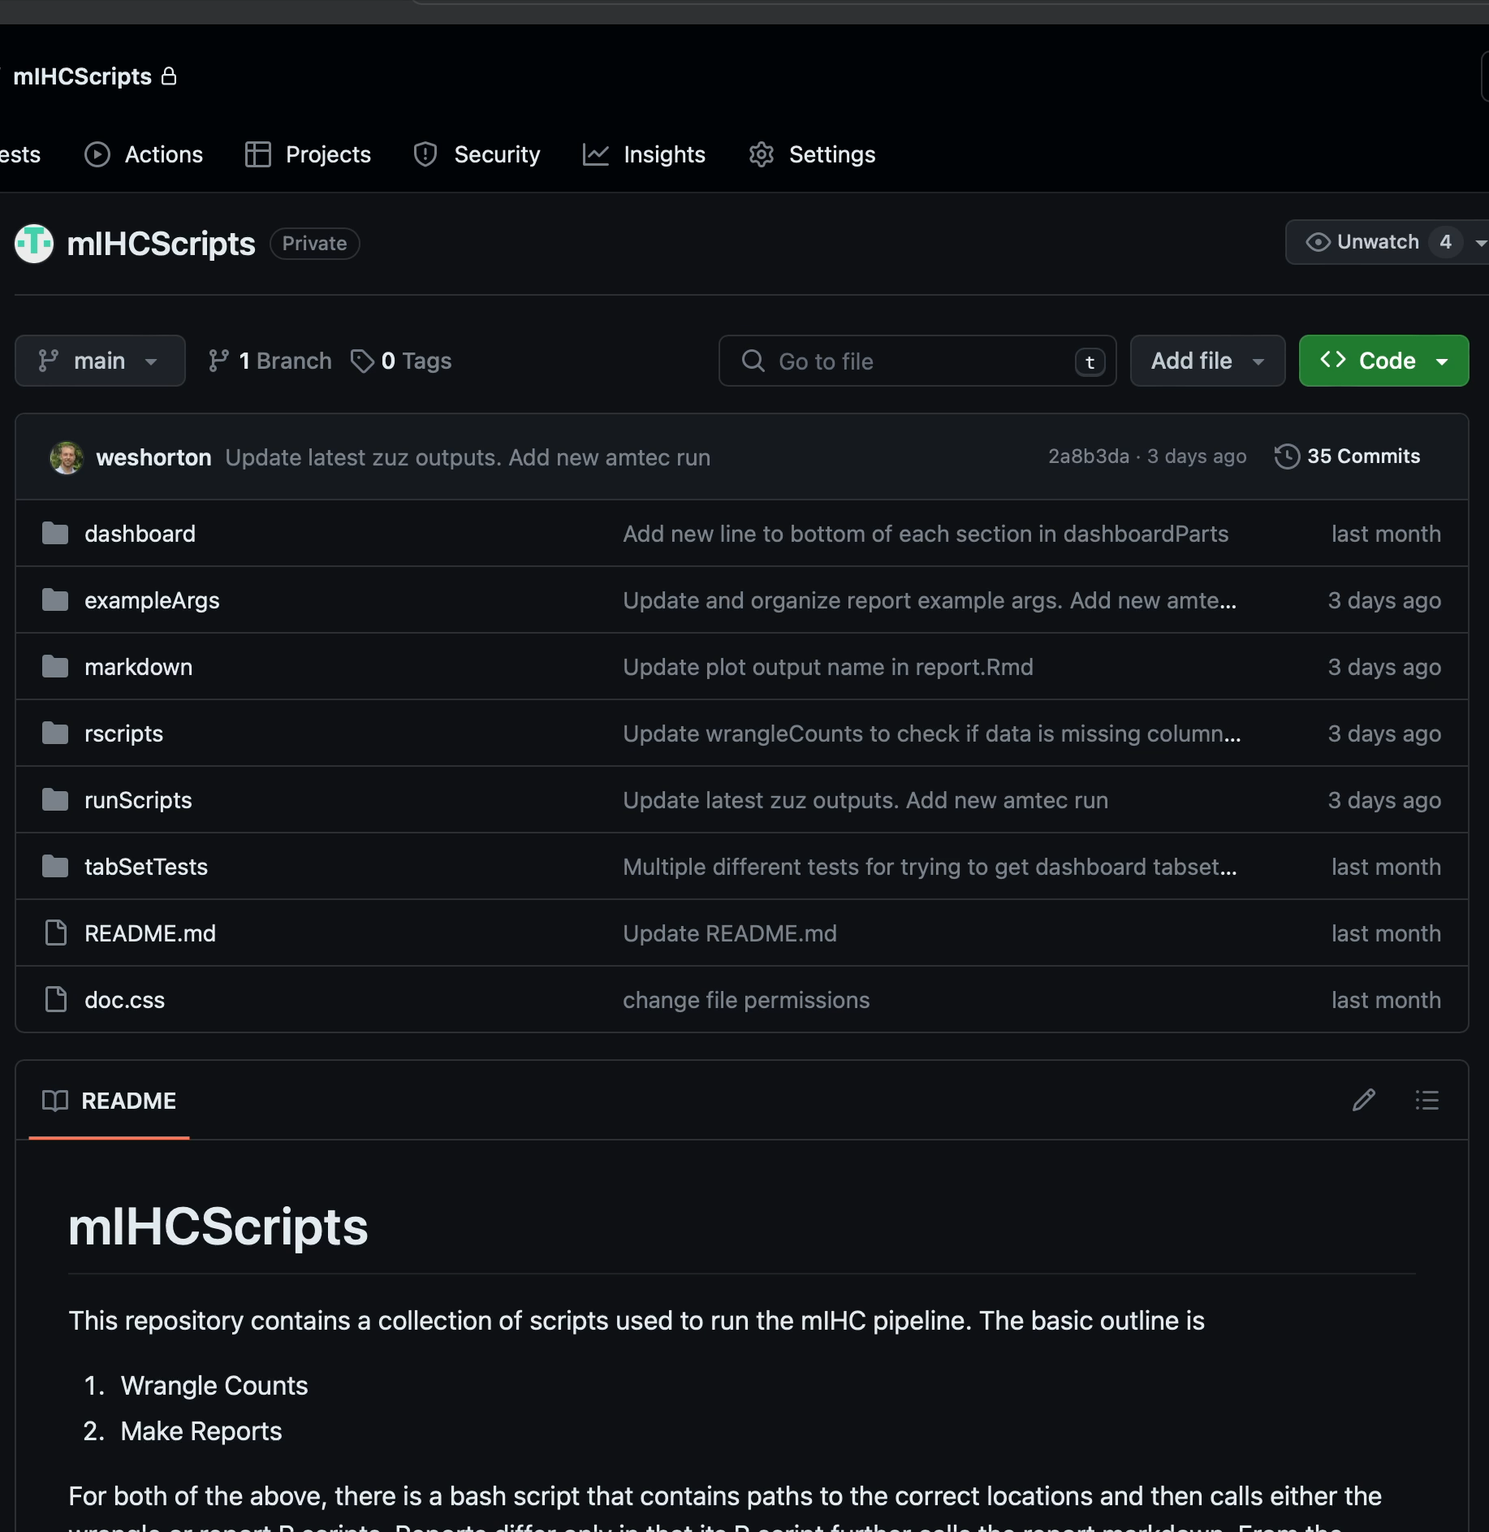
Sharing Code/Switching Locations
Anyone with a link and permission can access your repository
Share instructions, descriptions of the data, etc.
Have the exact same versions in multiple locations

Slide 21
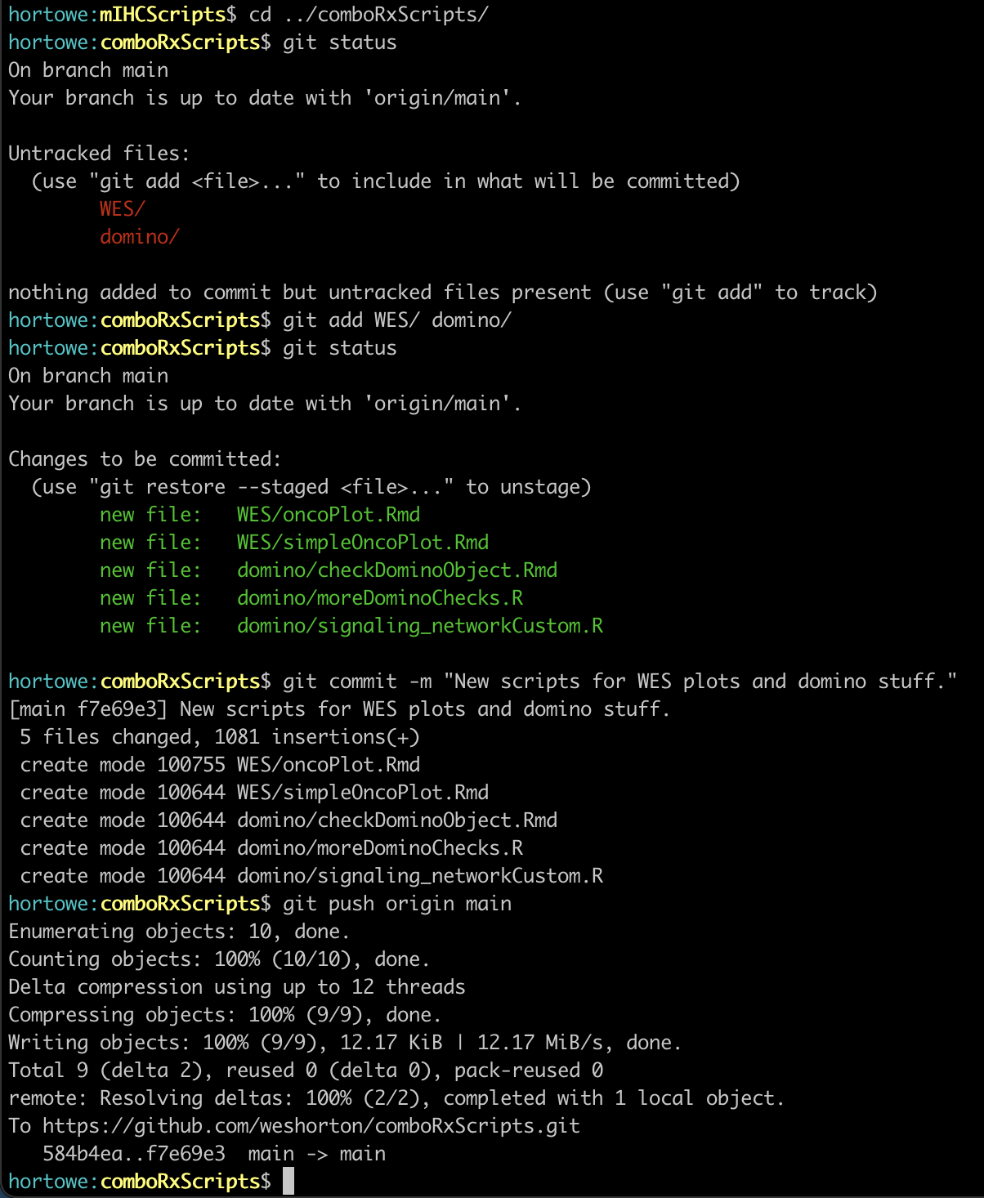
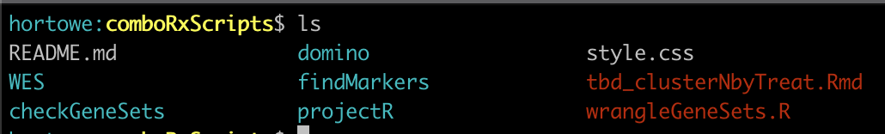
Sharing Code/Switching Locations
On my local computer:
Make new files
Anyone with a link and permission can access your repository
Share instructions, descriptions of the data, etc.
Have the exact same versions in multiple locations
Let git know about them and write a comment describing what you did
Upload your changes to the remote so others can access them

Slide 22
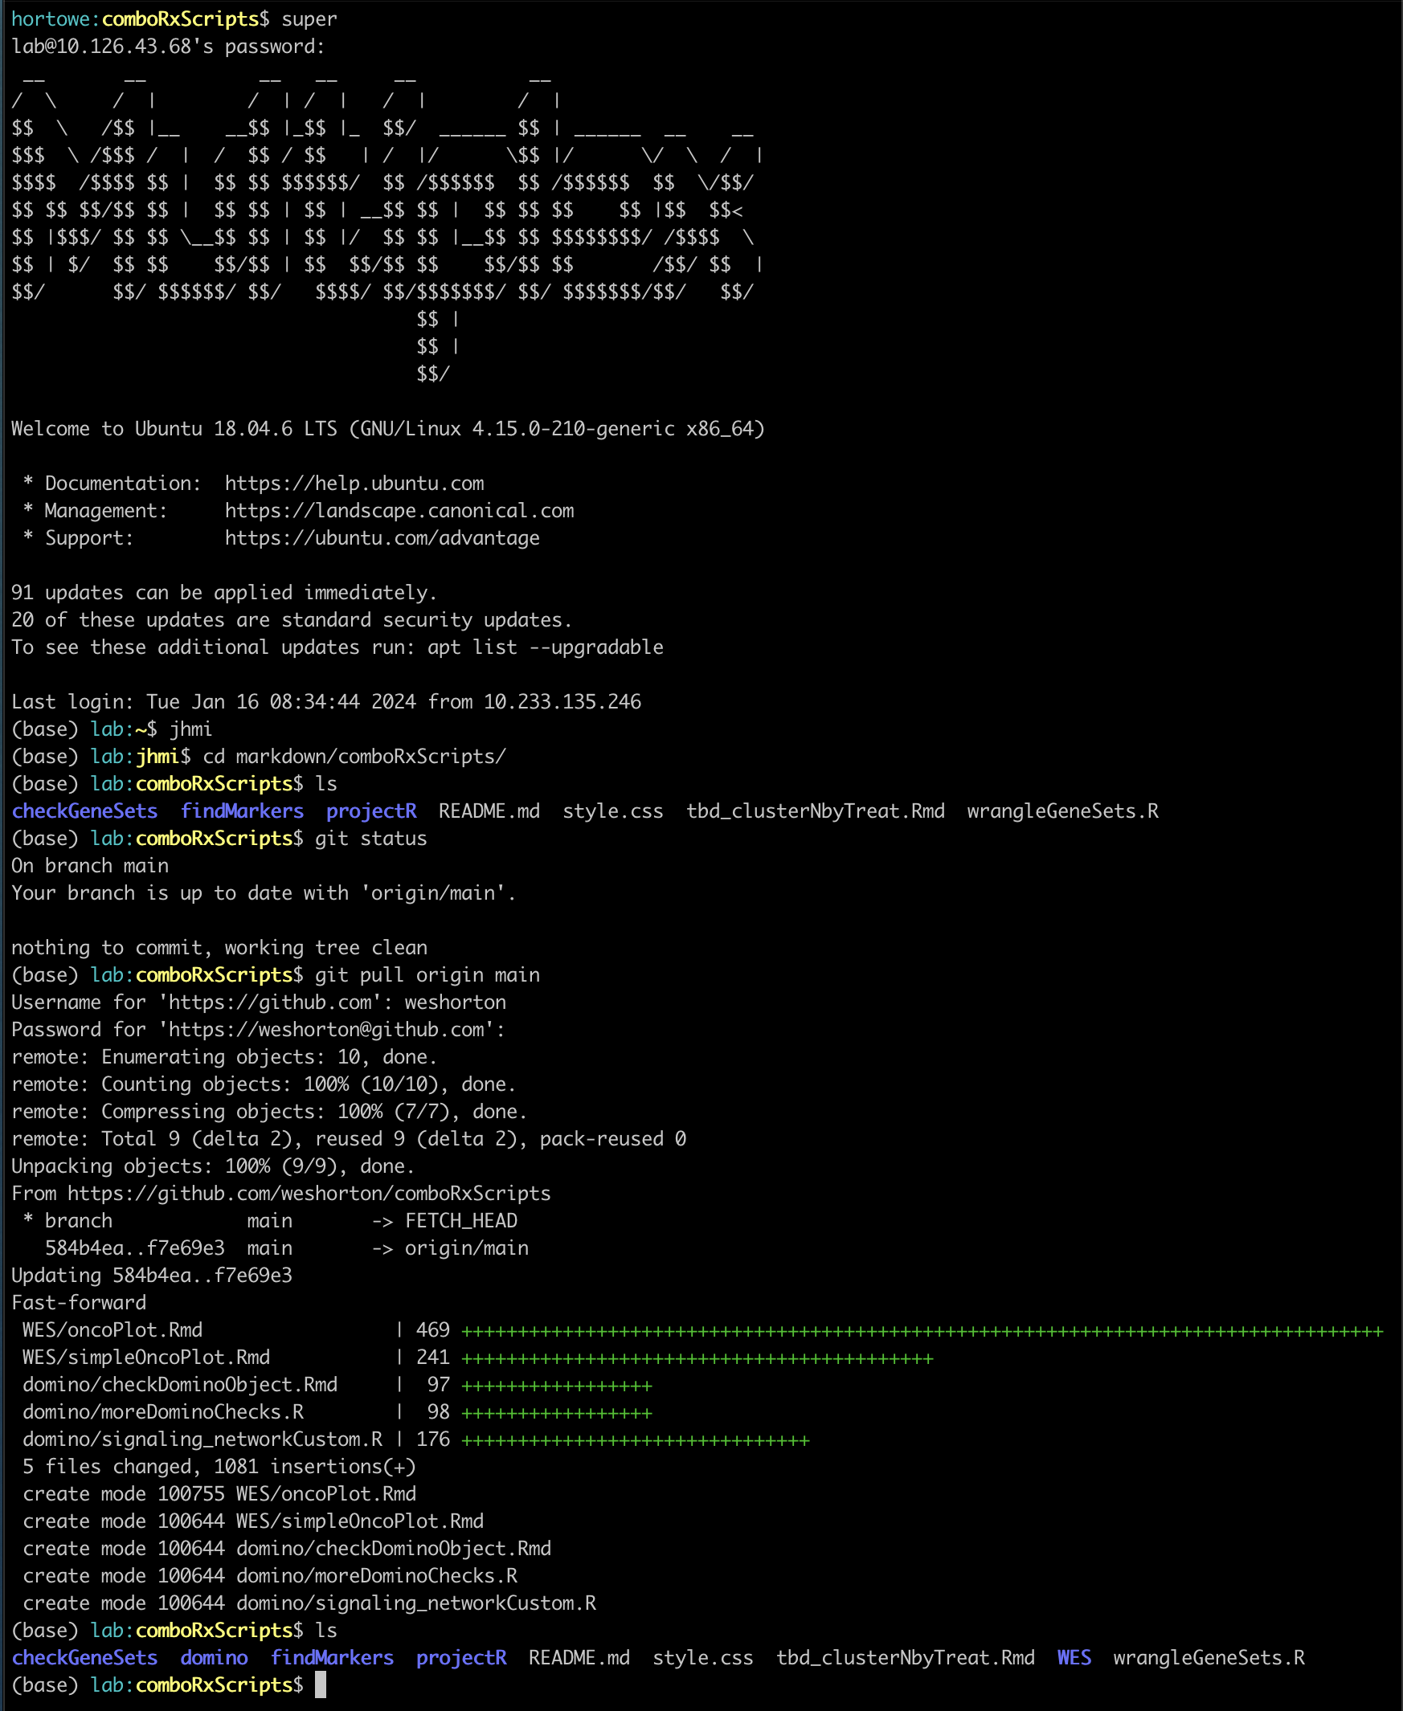
Sharing Code/Switching Locations
On the galaxy supercomputer:
Log in
Anyone with a link and permission can access your repository
Share instructions, descriptions of the data, etc.
Have the exact same versions in multiple locations
Review repository and see that WES and domino are missing
Download the changes

Slide 23
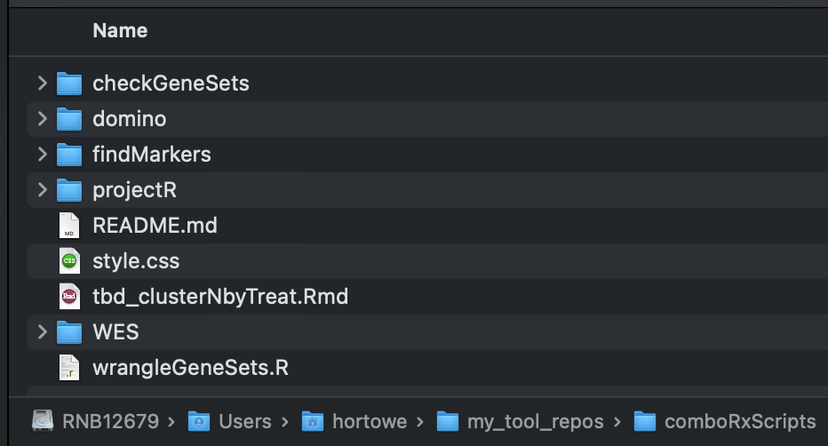
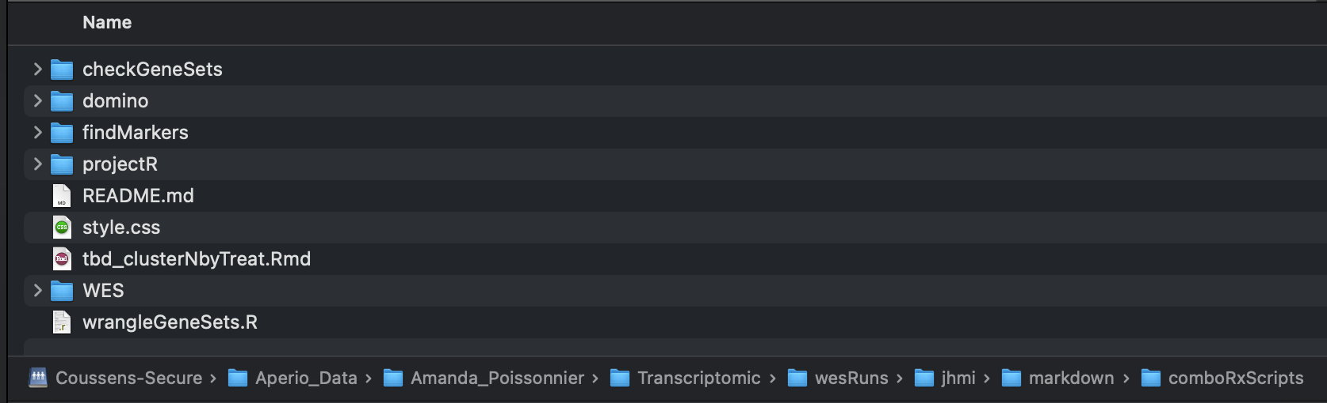
Sharing Code/Switching Locations
local
Anyone with a link and permission can access your repository
Share instructions, descriptions of the data, etc.
Have the exact same versions in multiple locations
server

Slide 24
How you can use git
Individually
Track projects
Data/results
Figures
Documents
Presentations
Collaboratively
Track changes to shared projects (manuscript edits, figure changes, etc.)
Easy way to share with others
Slightly more advanced

Slide 25
How you can use git
Track excel sheets
For example the custom gene sets that Amanda gave me for the scRNAseq project. Instead of using version numbers/dates, can just update
Track manuscripts
Can combine track changes with branches and commit logs for better documentation
Track data versions
Log where data came from and details (more information than just the created-by date)

Slide 26
Branching
Usually used to develop independent features in a code base without breaking already-built things
Can be utilized to work independently to make larger changes and review all of the changes with the larger project at a later date
Add figure 2
modify figure 2
finalize figure 2
figure 2 branch
Make collabDoc
Add figure 1
modify figure 1
finalize figure 1
add figure 3
main
Notes:
Already kind of showed you the general set up, but for this we’ll make a different branch.
Make a new branch
Make changes
Merge those changes

Slide 27
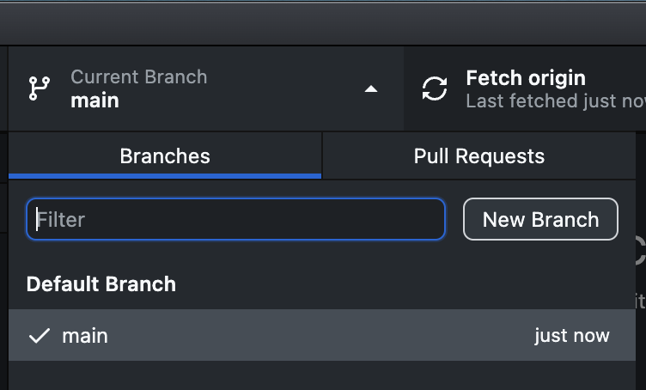
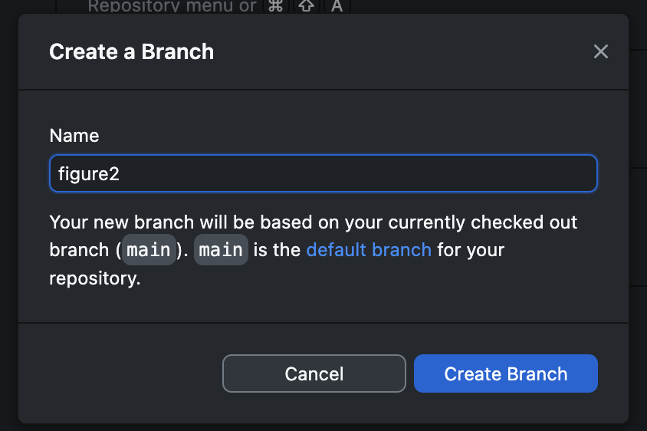
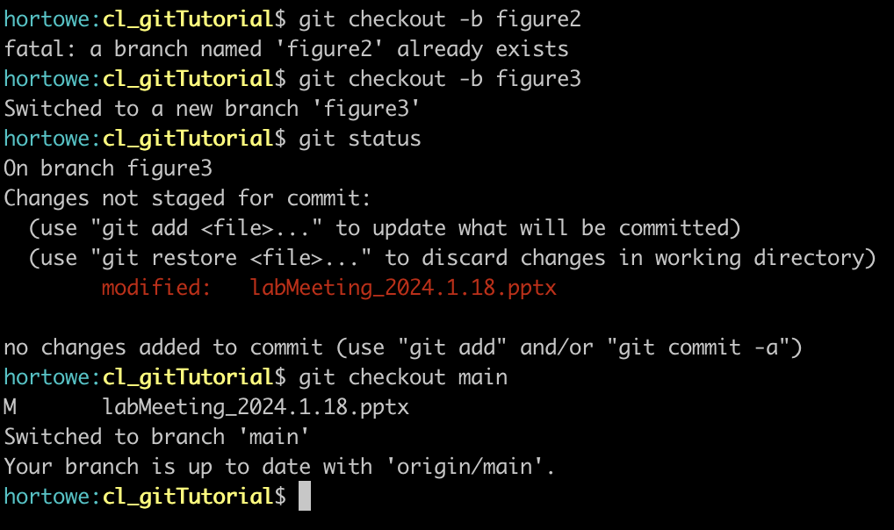
Branching
Create a new branch
Notes:
Already kind of showed you the general set up, but for this we’ll make a different branch.
Make a new branch
Make changes
Merge those changes

Slide 28
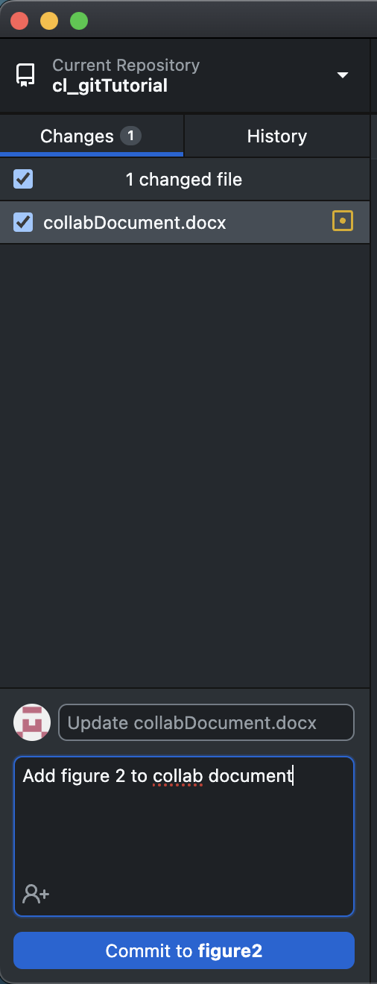
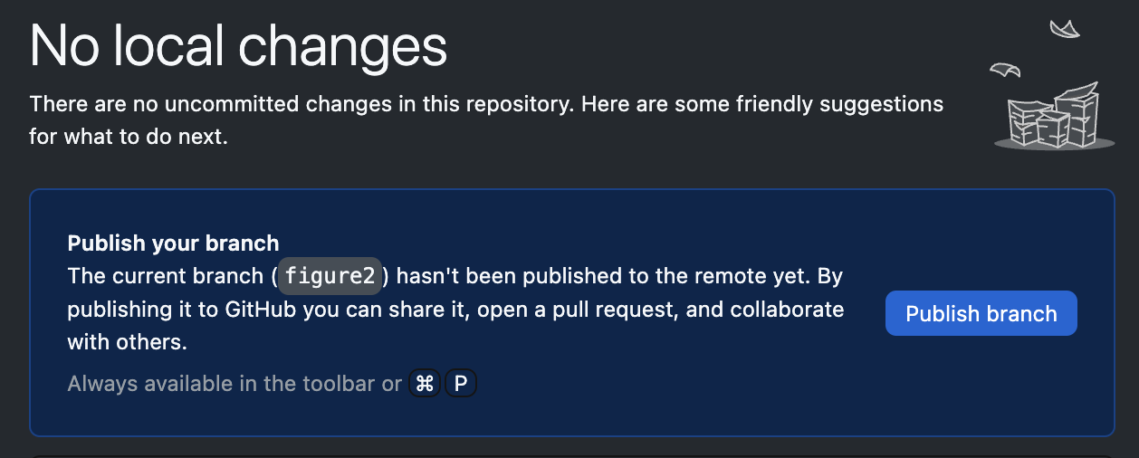
Branching
Change your file
Update changes
Push to remote (only when you’re done!)

Slide 29
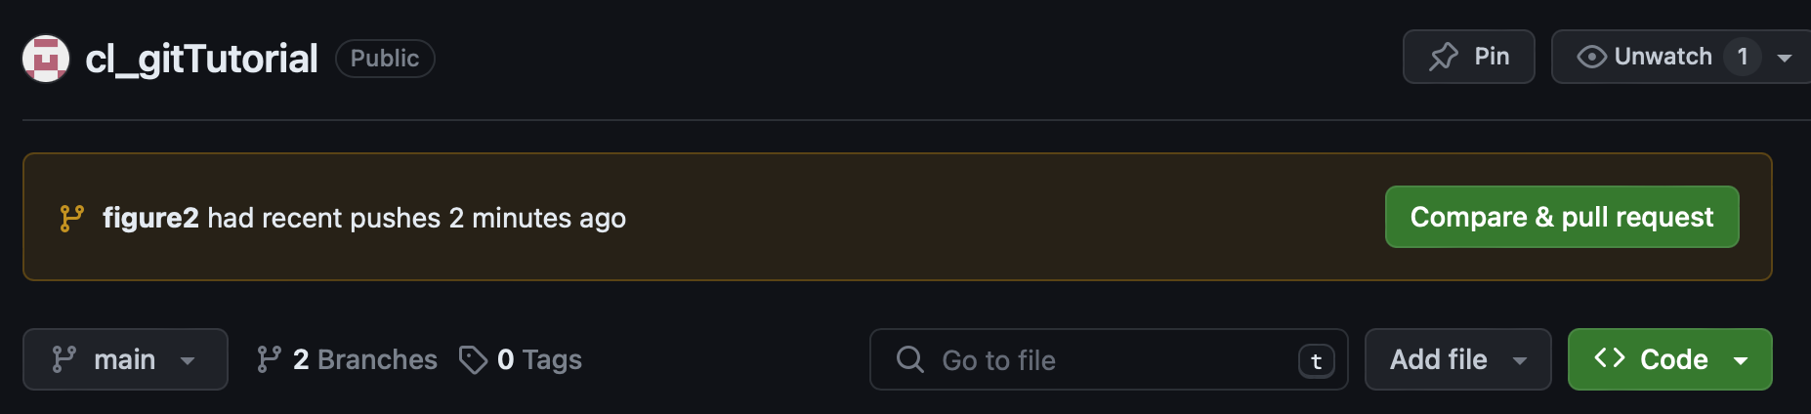
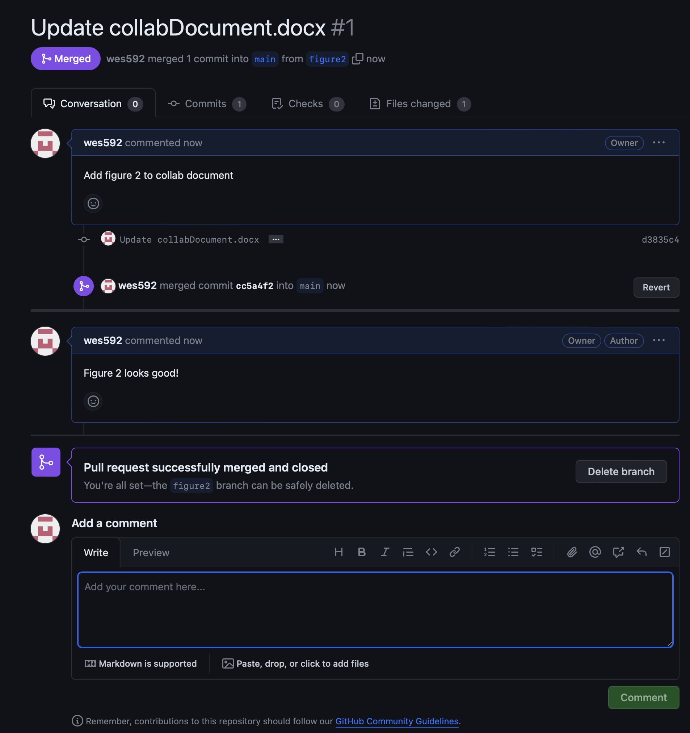
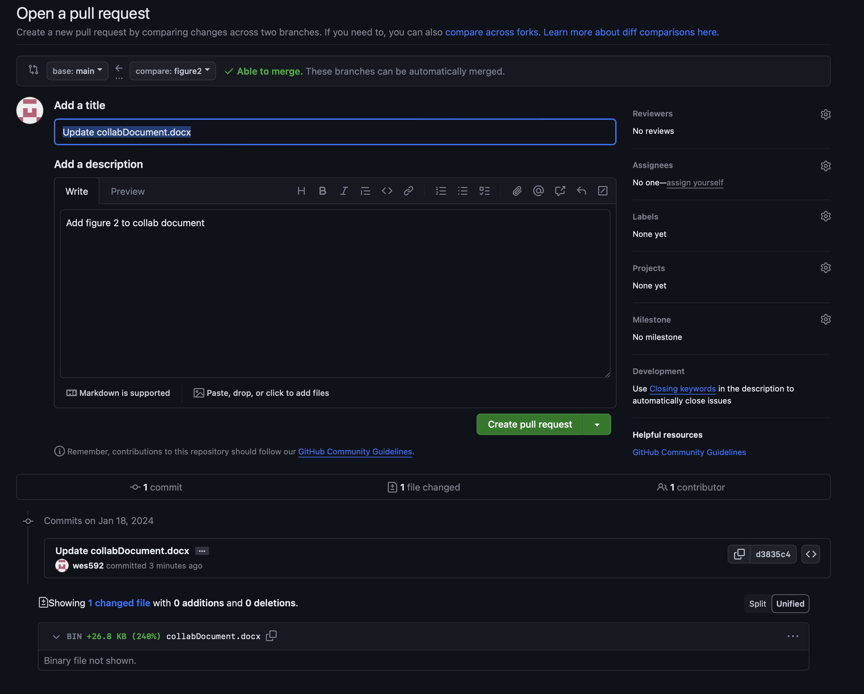
Branching
Change your file
Update changes
Push to remote

Slide 30
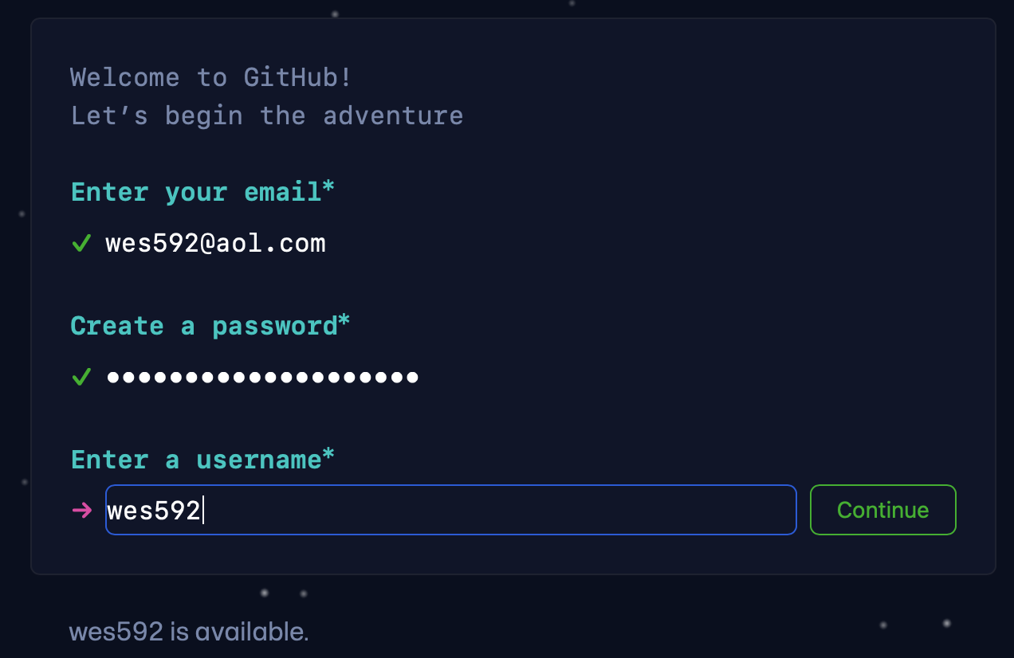
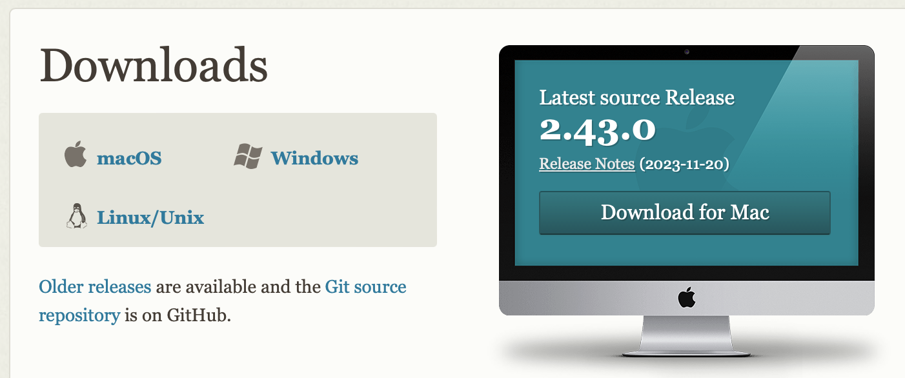
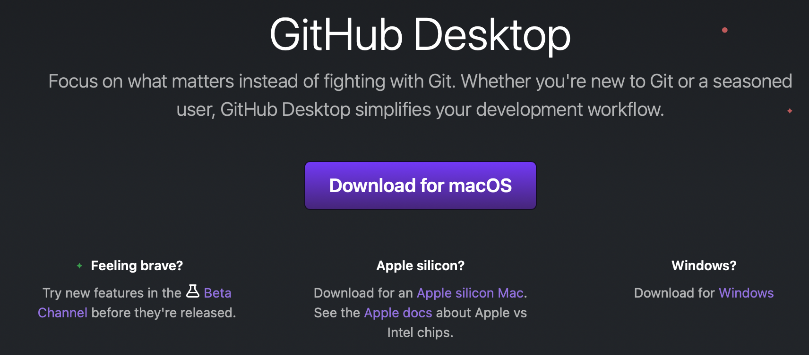
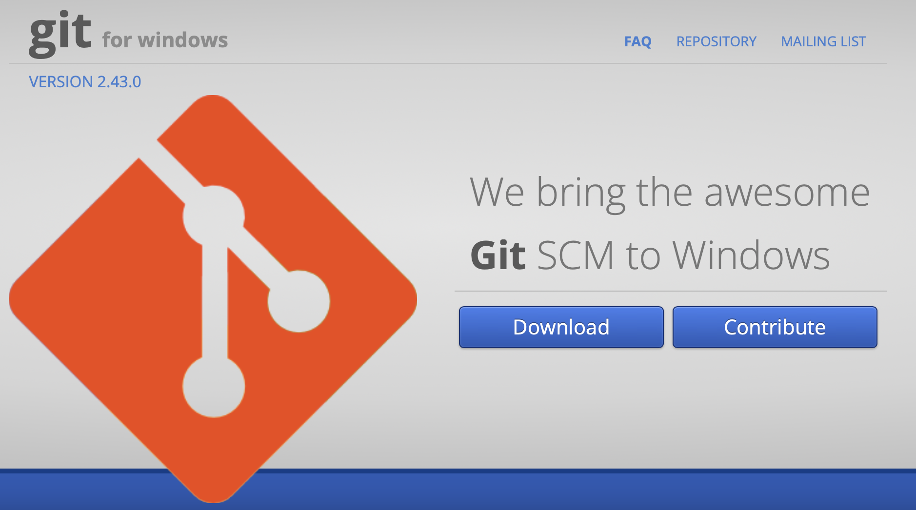
Tutorial – Set Up
Navigate to github.com and create a username
Download and install git (git-scm.com)
Download a GUI (git-scm.com/downloads/guis)
Easiest to start with github desktop (desktop.github.com)
Windows users: download git BASH (gitforwindows.org)

Slide 31
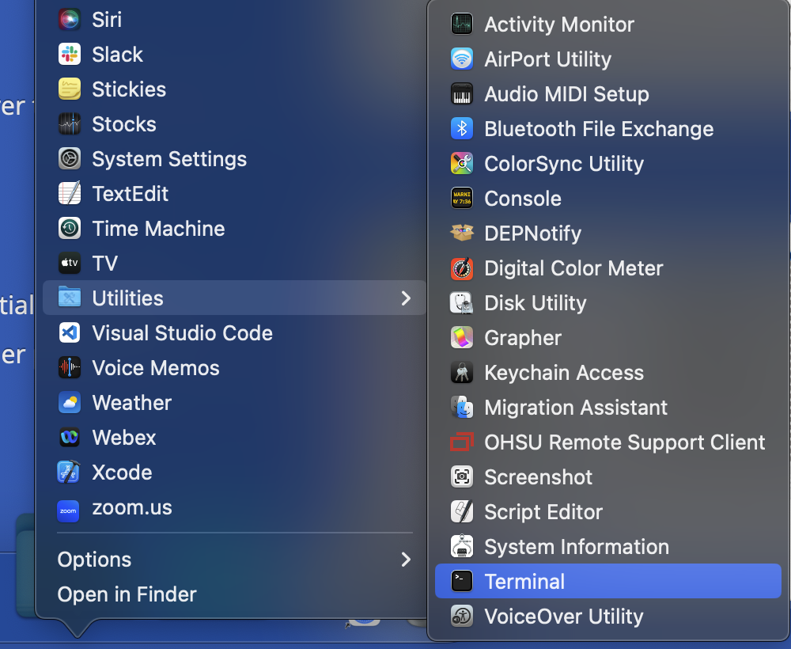
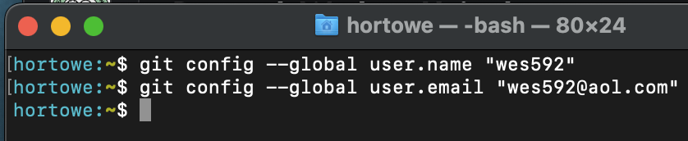
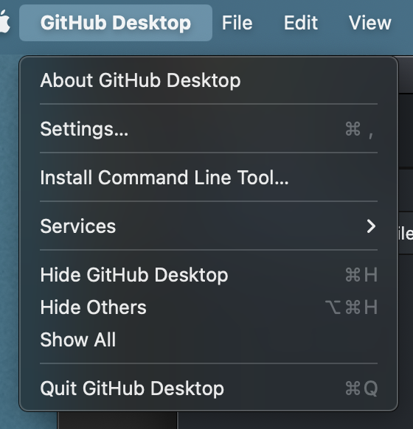
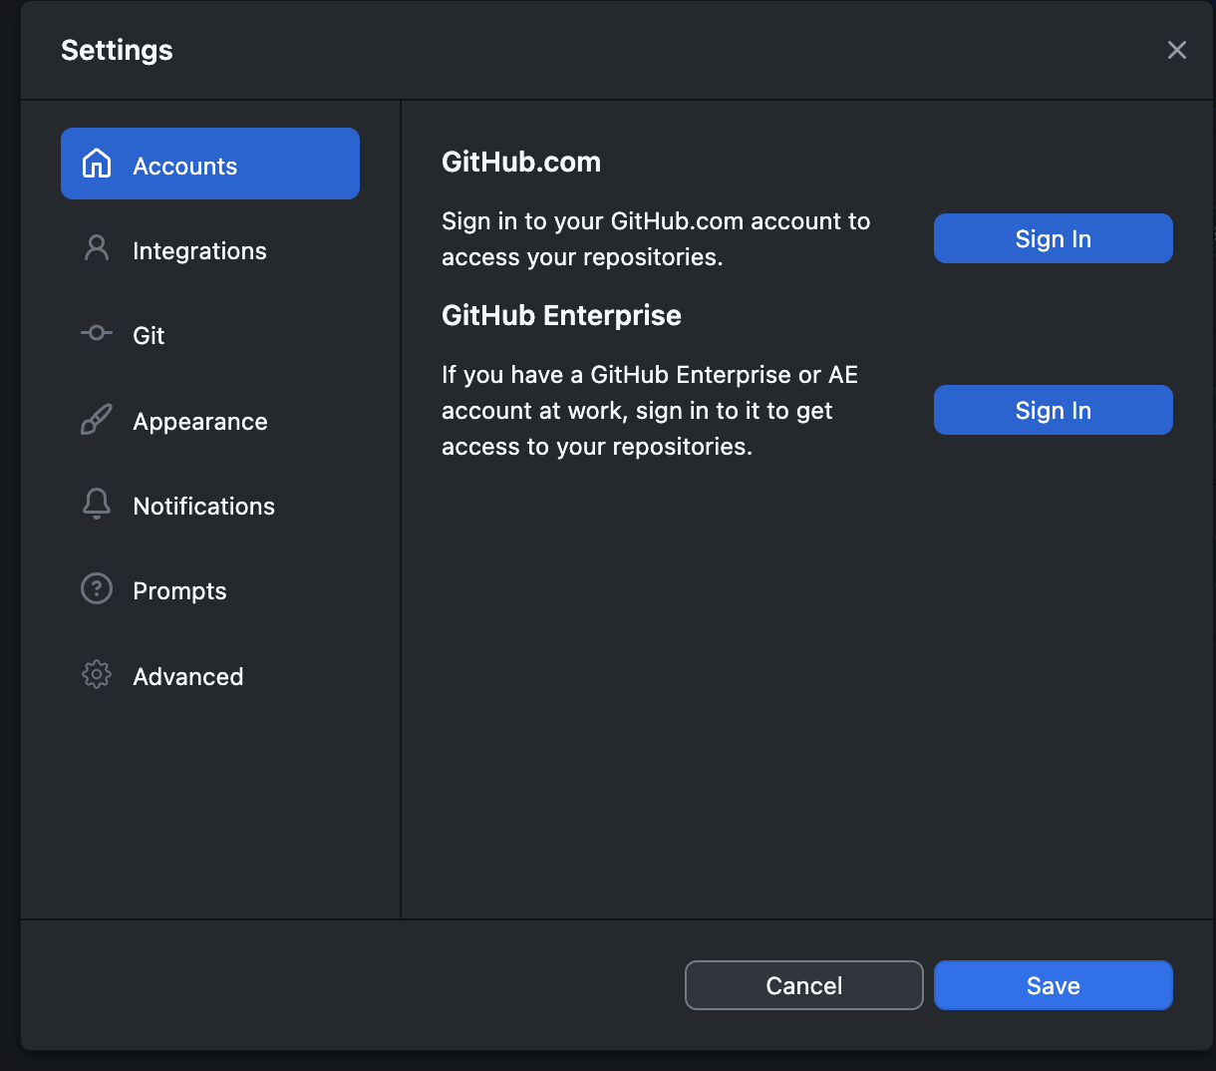
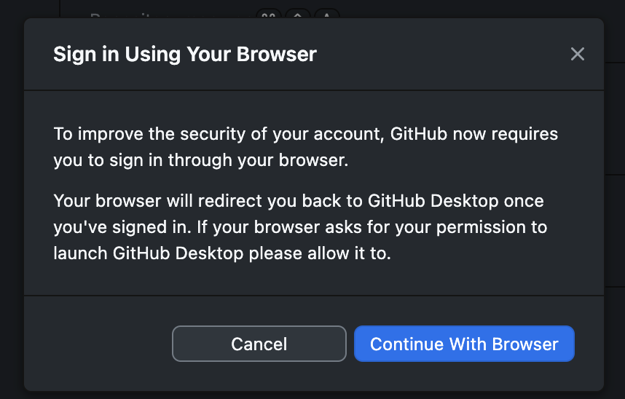
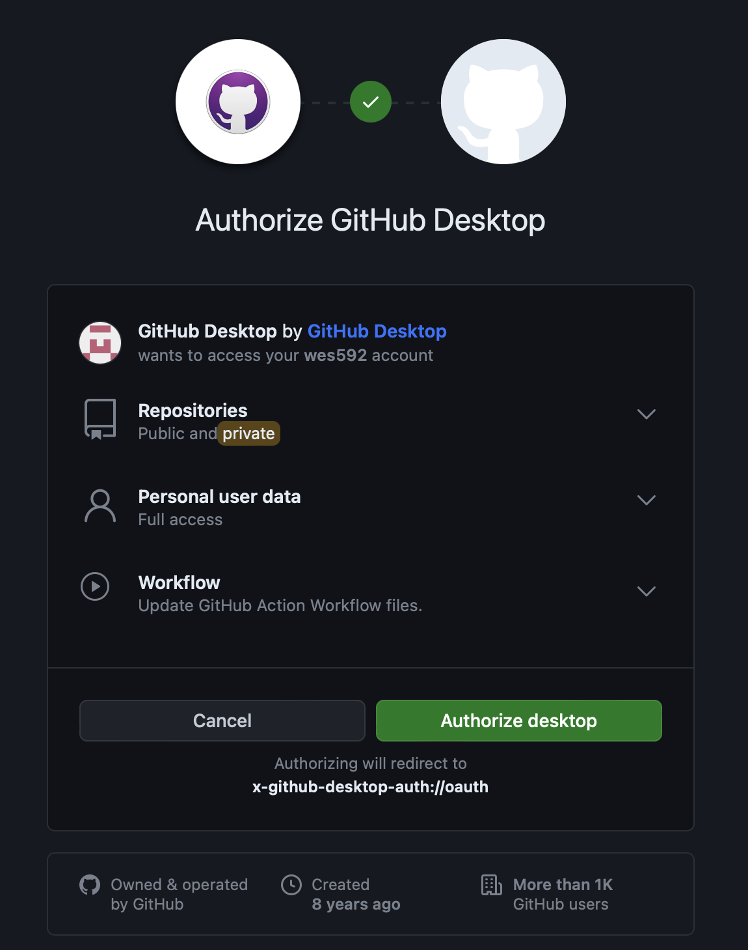
Tutorial – Initialize
Add your info to the config file (command line)
Authenticate GitHub Desktop

Slide 32
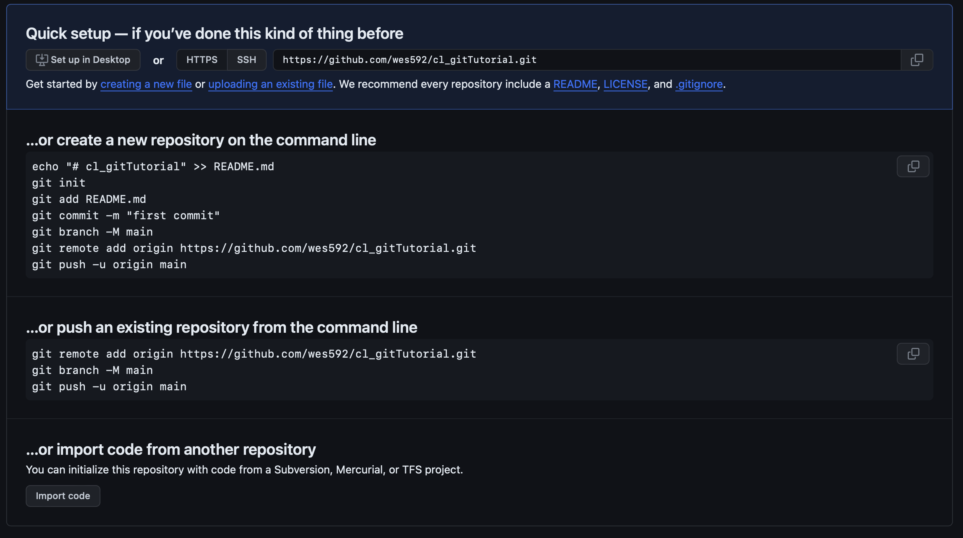
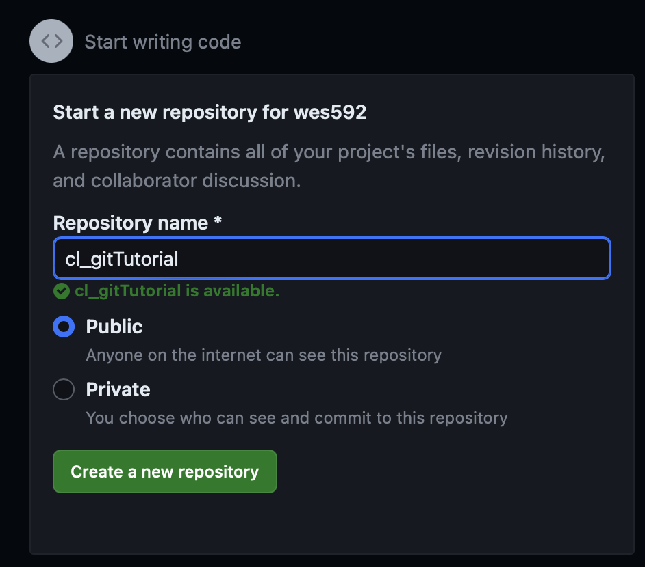
Tutorial – Access
Create your own repository
Fork an existing repository
Clone an existing repository

Slide 33
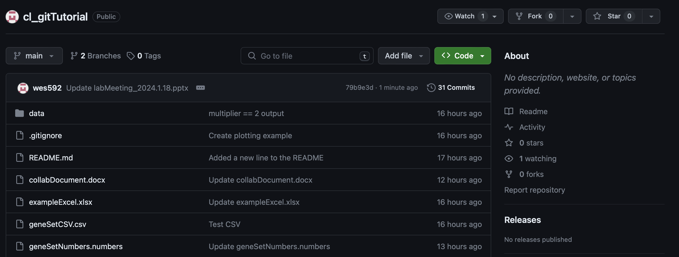
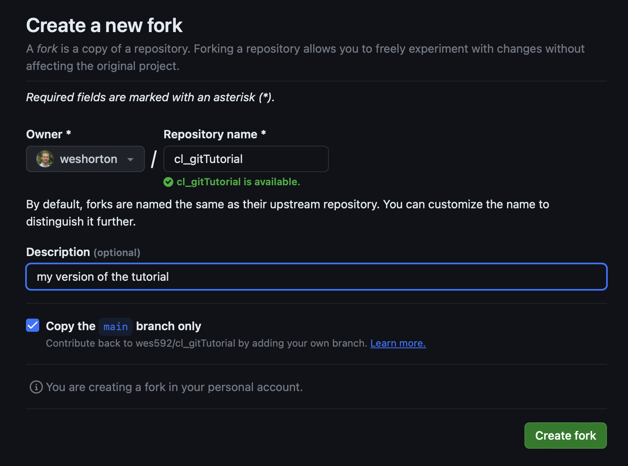
Tutorial – Access
Create your own repository
Fork an existing repository
Clone an existing repository

Slide 34
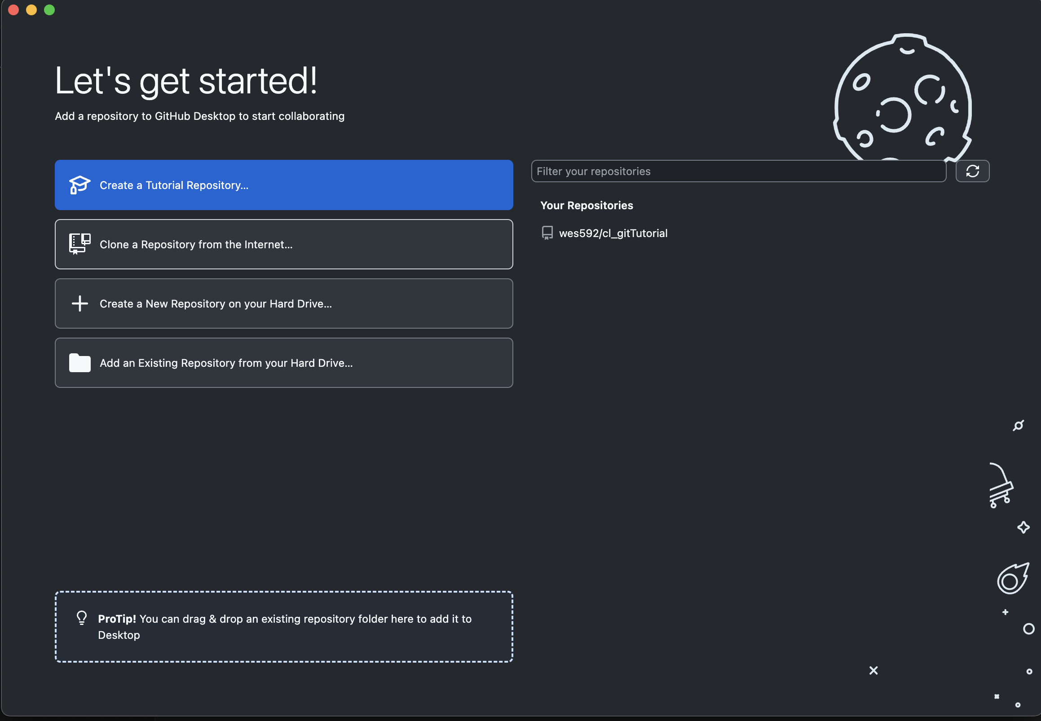
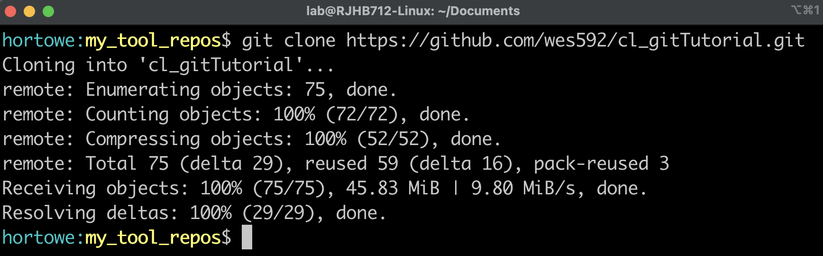
Tutorial – Access
App:
Create your own repository
Fork an existing repository
Any public repository
Clone an existing repository
Must be part of the project
Command Line:

Slide 35
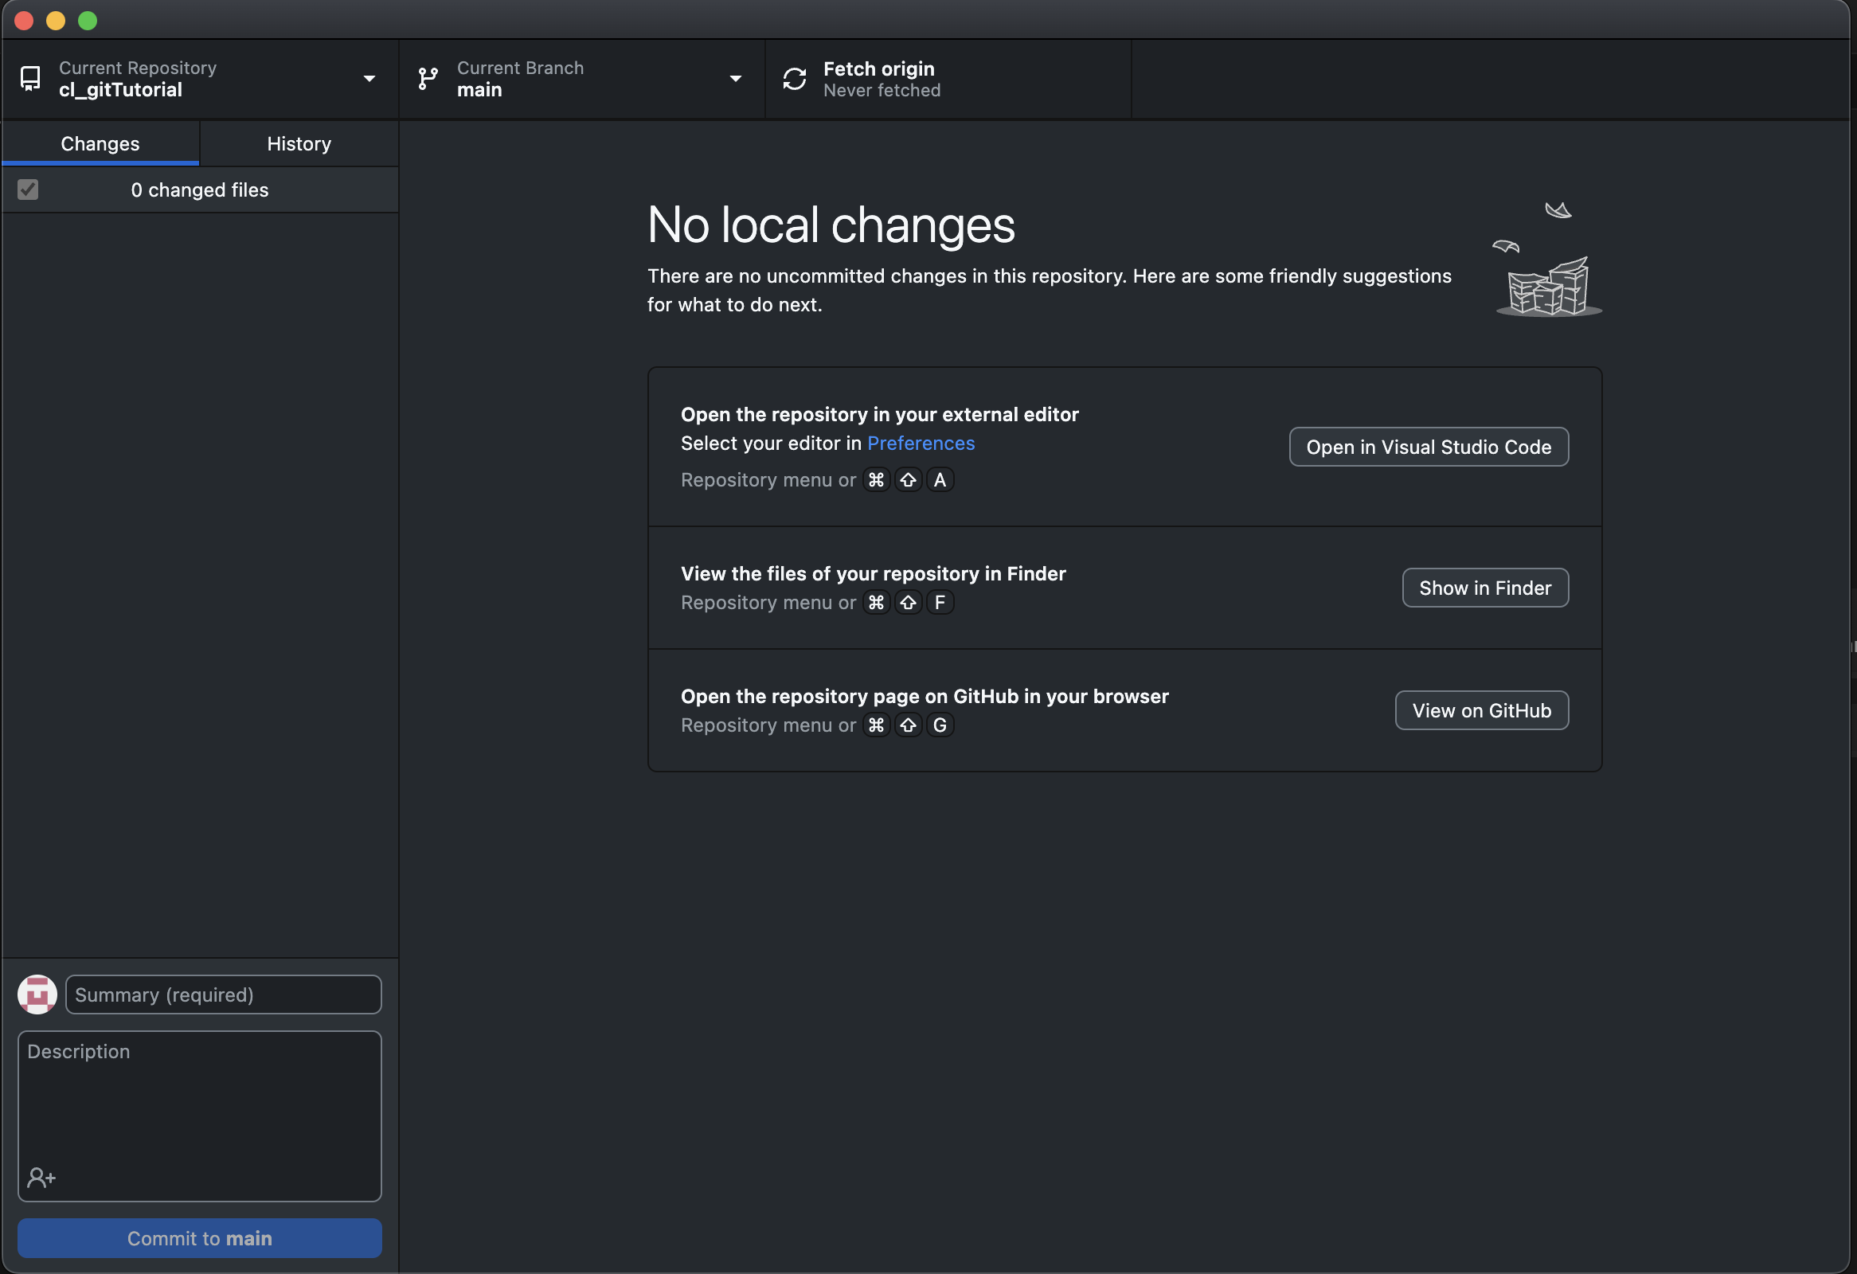
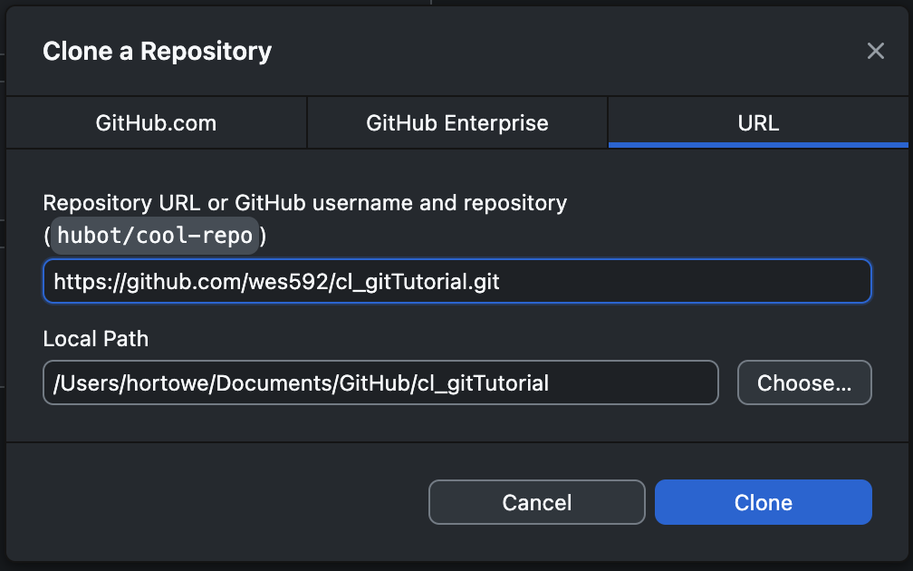
Tutorial – Access
Create your own repository
Clone an existing repository
After forking on github, update this to be:
github.com/username/cl_gitTutorial.git

Slide 36
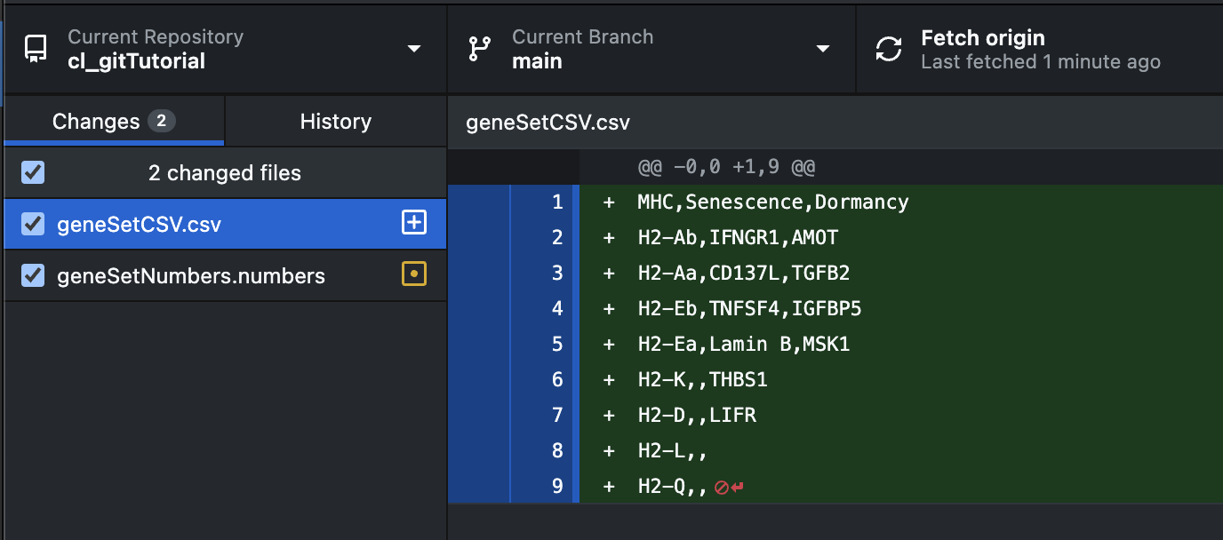

Tutorial – Adding Files
Any file that is added to your repository is automatically tracked by the desktop app
Open a new document of your choice (word, textEdit, excel, etc.)
.txt or .csv is best for the tutorial
Type a few lines
Save it to your repository (likely /Users/username/Documents/GitHub/cl_gitTutorial/)
Check the app for the changes to be noticed

Slide 37



Tutorial - Pushing Files
The desktop app has a dialog box for you to write your commit message and commit your new file
Afterwards, a new option to push to origin will pop up
If using the command line, you have to tell git that you added a new file and then make your message

Slide 38


Tutorial – Changing Files
As soon as you save any edits to your file, the app automatically tracks them and shows you the changes
Again, add a commit message and then push

Slide 39



Tutorial – Checking History
You can check your history on the app or on the website
Also on the command line as “git log”

Slide 40
Comments
Commit, commit, commit!
Be detailed, don’t assume you’ll remember what you meant
As mentioned, git’s full power can be used with text files, the binary files that we use still require a little manual review
Theoretically, anything can be a git repo

Slide 41
Resources
Git website: https://git-scm.com
Free, comprehensive Pro Git book: https://git-scm.com/book/en/v2
Atlassian tutorials: https://www.atlassian.com/git/tutorials
Google and stackoverflow!
Me ☺

Slide 42


Extra – Merging Forks
After doing changes on a forked branch, navigate to the main repository and create a pull request
Tell github which fork you want to compare, and create the pull request

Slide 43

Extra – Merging Forks
Github will show you the differences

Slide 44

Extra – Merging Forks
Write a merge message

Slide 45

Extra – Merging Forks
Now it goes to the maintainer of the repository for review
I forgot to take a screenshot before I approved the merge…

Slide 46
Managing Large Files
Standard git/github has a recommended file size limit of 50 MB
Many files will be within this range, but powerpoint, illustrator, and prism files can quickly exceed this range
Git LFS is git’s large file storage system (git-lfs.com)
It hosts all of the files remotely, but only keeps text pointers to these files on the local copy.
The free version of github has a limit of 2GB, while the enterprise’s limit is 5GB.
Unfortunately, we can’t used lfs on forked public repositories, so unless we get enterprise, the forking feature won’t be available.
This may not be an issue if we just use branches instead

